Slide 1
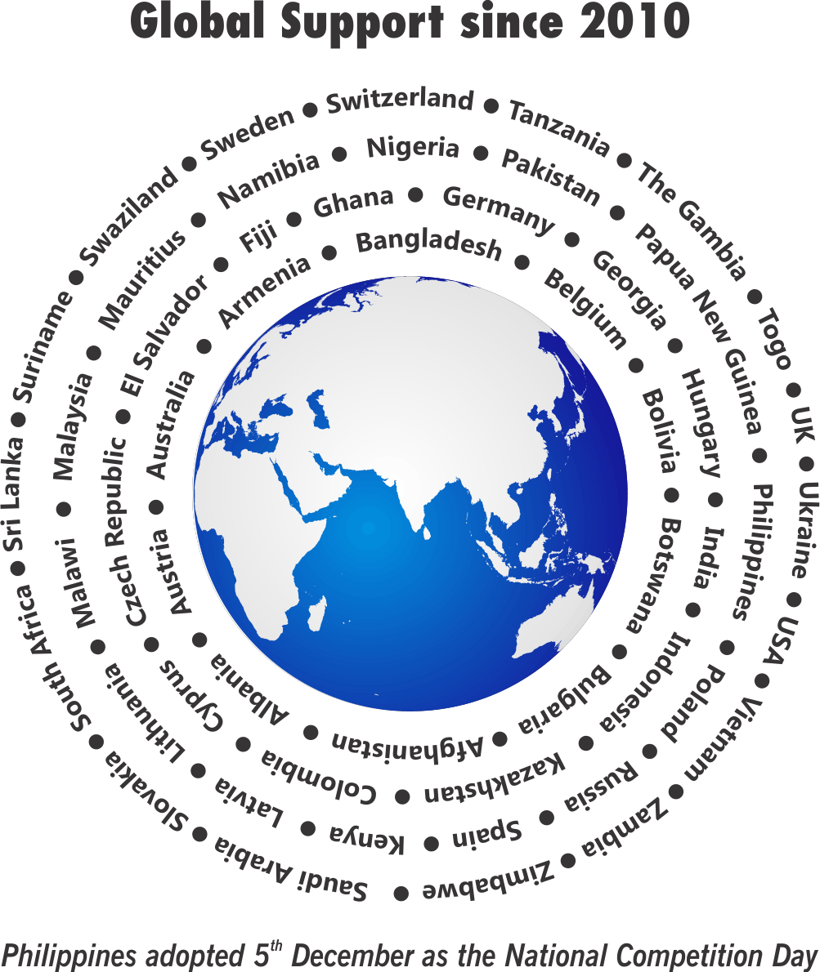
Theme
Competition Policy and Access to Healthcare

Slide 2
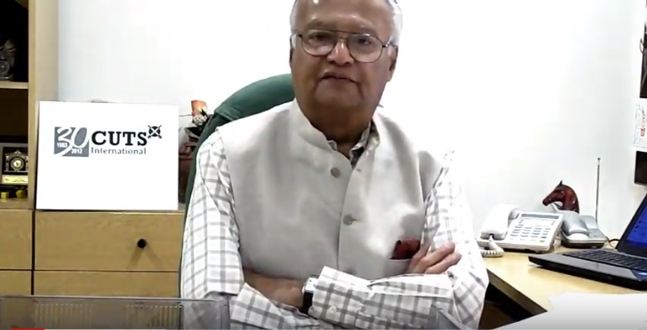
Why World Competition Day?
Pradeep S Mehta
Secretary General, CUTS International

Slide 3
Themes… since 2010
2010 International Air-transport Cartels and its Impact on Developing Countries
2011 Cartels and their Harmful Effects on Consumers
2012 & 2013 Adverse Impact of Cartels on the Poor
2014 & 2015 Competition Issues in Public Procurement
2016 Linkages between Competition and Intellectual Property
2017 Re-imagining Competition Policy and Law in the Era of Disruption
2018 Digital Economy, Innovation and Competition
2019 Ensuring Effective Competition in an Increasingly Online World
2020 Competition Policy and Access to Healthcare

Slide 4
Support from Countries... since 2010
Competition agencies expressed support towards a formal adoption of the Day
Competition Promotion and Consumer Protection Directorate, Afghanistan
Albanian Competition Authority, Albania
The State Commission for the Protection of Economic Competition of Armenia
Austrian Federal Competition Authority, Austria
Competition Commission of Bangladesh

Slide 5
Support from Countries... since 2010
Competition agencies expressed support towards a formal adoption of the Day
The European Commission - Directorate-General for Competition
Competition and Consumer Authority, Botswana
Commission on Protection of Competition, Bulgaria
Superintendence of Industry and Commerce, Colombia
Commission for the Protection of Competition, Cyprus

Slide 6
Support from Countries... since 2010
Competition agencies expressed support towards a formal adoption of the Day
The Office for the Protection of Competition, Czech Republic
Competition Superintendence (SC), El Salvador
Estonian Competition Authority
Fiji Commerce Commission, Fiji
Gambia Competition Commission, Gambia

Slide 7
Support from Countries... since 2010
Competition agencies expressed support towards a formal adoption of the Day
Competition Agency of Georgia
Bundeskartellamt, Germany
The Hungarian Competition Authority (GVH), Hungary
Competition Protection Agency, Republic of Kazakhstan
Competition Authority of Kenya

Slide 8
Support from Countries... since 2010
Competition agencies expressed support towards a formal adoption of the Day
Competition Council, Republic of Latvia
Competition Council of the Republic of Lithuania
Competition and Fair Trading Commission, Malawi
COMESA Competition Commission, Malawi
Competition Commission of Mauritius

Slide 9
Support from Countries... since 2010
Competition agencies expressed support towards a formal adoption of the Day
Namibian Competition Commission, Namibia
Federal Competition and Consumer Protection Commission, Nigeria
Competition Commission of Pakistan
Independent Consumer and Competition Commission, Papua New Guinea
Office of Competition and Consumer Protection (UOKiK), Poland

Slide 10
Support from Countries... since 2010
Competition agencies expressed support towards a formal adoption of the Day
Philippines adopted 5th December as a National Competition Day
Federal Antimonopoly Service, Russia
General Authority for Competition, Saudi Arabia
Fair Trading Commission, Seychelles
Antimonopoly Office of the Slovak Republic, Slovakia

Slide 11
Support from Countries... since 2010
Competition agencies expressed support towards a formal adoption of the Day
Spanish Competition Authority (CNC), Spain
Competition Tribunal, South Africa
Consumer Affairs Authority, Sri Lanka
Eswatini Competition Commission, Swaziland
Swedish Competition Authority (KONKURRENSVERKET) Sweden

Slide 12
Support from Countries... since 2010
Competition agencies expressed support towards a formal adoption of the Day
Swiss Competition Commission (COMCO)
Fair Competition Commission, Tanzania
Trinidad and Tobago Fair Trading Commission
Office of Fair Trading, United Kingdom
The Antimonopoly Committee of Ukraine

Slide 13
Support from Countries... since 2010
Competition agencies expressed support towards a formal adoption of the Day
Vietnam Competition Authority, Vietnam
Competition and Consumer Protection Commission, Zambia
Competition and Tariff Commission, Zimbabwe

Slide 14
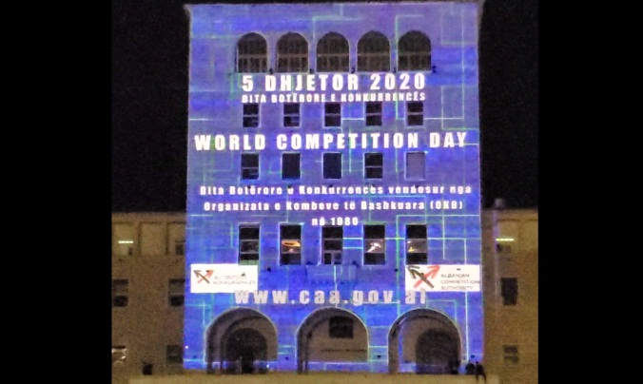
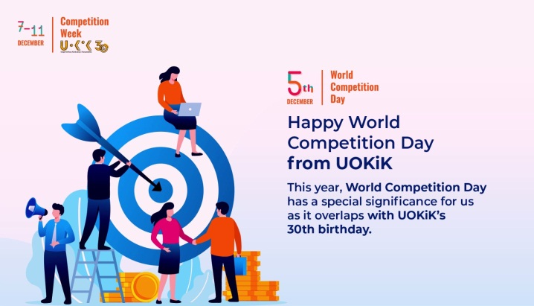
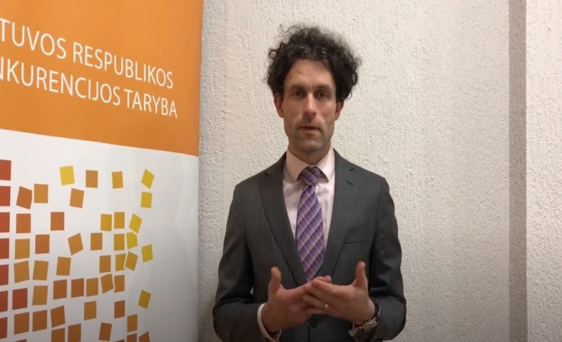
‘Videos’ expressing support to adopt WCD
Fair Trading Commission, Seychelles
Competition Authority of Albania
Tomasz Chróstny
Office of Competition and Consumer Protection, Poland
Šarūnas Keserauskas
Competition Council Lithuania

Slide 15
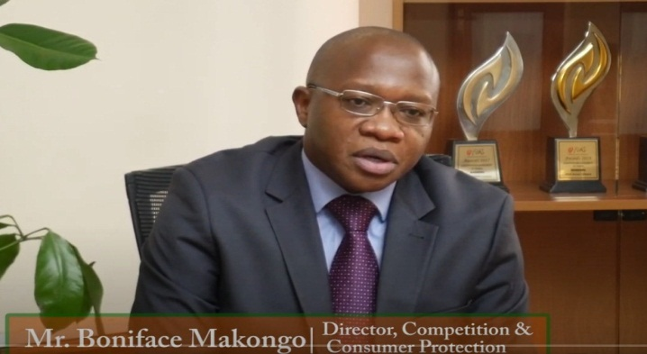
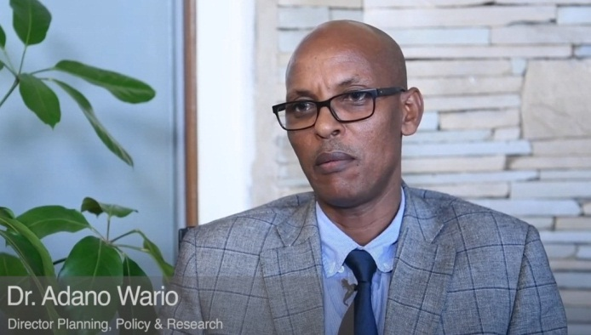
‘Videos’ expressing support to adopt WCD
Boniface Makongo
Competition Authority of Kenya
Adano Wario
Competition Authority of Kenya
The Trinidad and Tobago Fair Trading Commission
Deutsche Gesellschaft für Internationale Zusammenarbeit (GIZ)

Slide 16
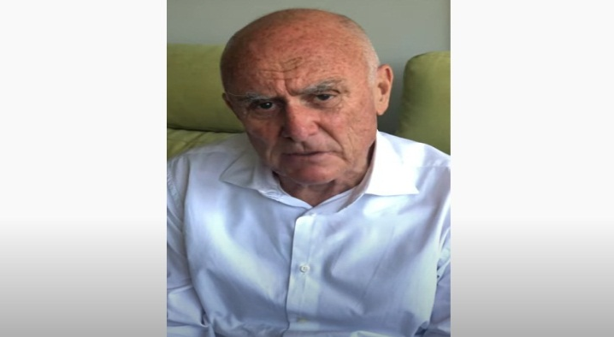
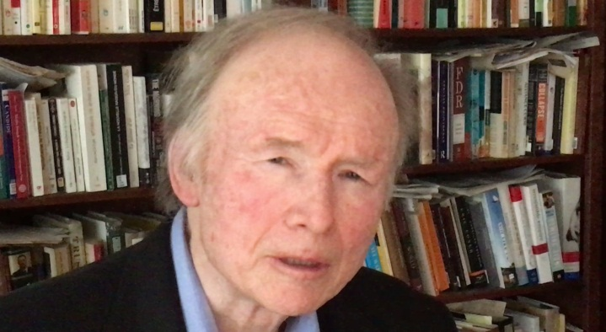
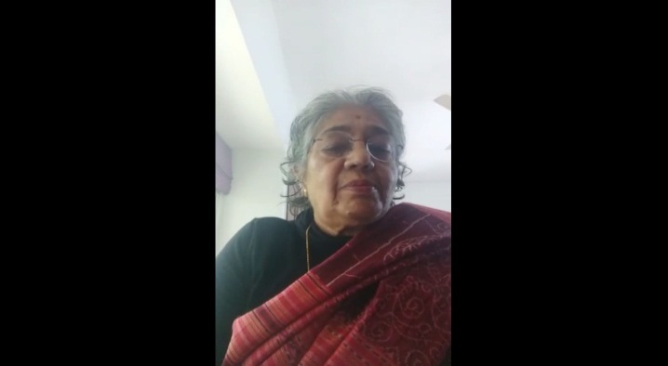
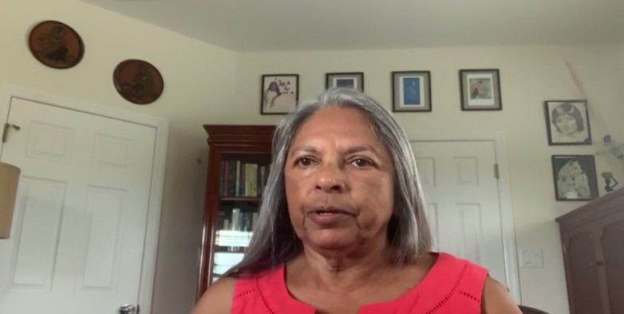
‘Videos’ expressing support to adopt WCD
Allan Fels
Former Chairperson, ACCC
David J. Gerber
Chicago-Kent College of Law
Geeta Gouri
Former Member, CCI, India
Taimoon Stewart
University of West Indies

Slide 17
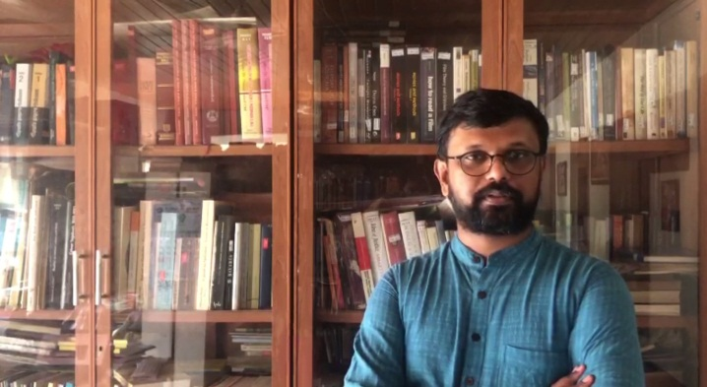
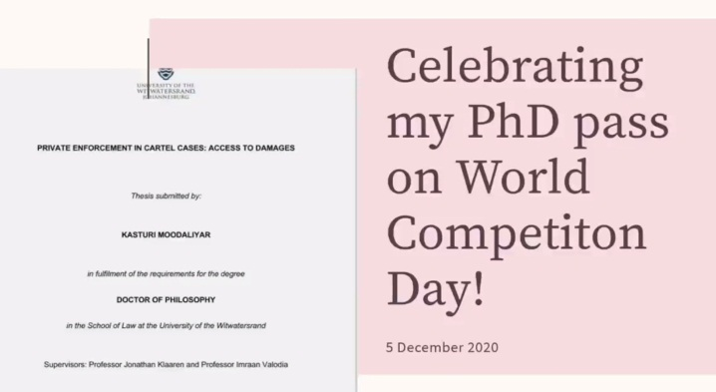
‘Videos’ expressing support to adopt WCD
Arul George Scaria
National Law University Delhi
Kasturi Moodaliyar
University of Witwatersrand

Slide 18
‘Actions’ taken around the world…2020
Media/Social Media | Country
Access to Healthcare and Competition Policy - 4 December 2020 (online event) The European Business Council of Africa, December 03, 2020 | Belgium
Competition and Consumer Authority celebrates World Competition Day CCA Press Release Botswana Guardian | Botswana
World Competition Day highlights the significance of the fair competition for the economies of countries all around the world Office for the Protection of Competition, Press Release, December 05, 2020 | Czech Republic

Slide 19
‘Actions’ taken around the world…2020
Media/Social Media | Country
World Competition day, 5th December Info-graphic, Superintendency of Competition | El Salvador
CUTS International releases tool kit on ''competition and access to healthcare'‘ December 04, 2020 Outlook Yahoo News Devdiscourse As Covid-19 Continues, CUTS’ World Competition Day Celebrations Raises Questions on whether strong IPR has helped Innovation or Not APN News, December 05, 2020 Has WTO TRIPS Agreement of IPR promoted global innovation The Economic Times, December 05, 2020 | India

Slide 20
‘Actions’ taken around the world…2020
Media/Social Media | Country
We need a 2nd Declaration on WTO TRIPs and Public Health December 17, 2020 PNI News APN News The Economic Times Outlook India Devdiscourse PharmaBiz Consumer Protection under the Competition Law By Surendra U Kanstiya | India
Enhancing access to healthcare through competition enforcement December 03, 2020 The Star Twitter Competition rules remove barriers to good healthcare Business Daily, December 07, 2020 | Kenya

Slide 21
‘Actions’ taken around the world…2020
Media/Social Media | Country
KP and PMB celebrate World Competition Day with a discussion on the most useless obstacles in procurement KP Press Release, December 04, 2020 | Latvia
Pasaulinė konkurencijos diena (World Competition Day) Facebook (Competition Council of the Republic of Lithuania) December 05, 2020 | Lithuania
Message from the Director & CEO of the COMESA Competition Commission, on the commemoration of World Competition Day, 2020 Press Release December 05, 2020 Commemoration of World Competition Day CFTC Press Release, December 03, 2020 | Malawi

Slide 22
‘Actions’ taken around the world…2020
Media/Social Media | Country
World Competition Day 5 December 2020 Times TV, December 05, 2020 Speech by the Board Chair Dr. Jerry Jana on the commemoration of World Competition Day CFTC Blog, December 09, 2020 | Malawi
CUTS International Celebrates the World Competition Day The Competition Commission, December 03, 2020 Press Release Facebook The CAP In Favor Of A Regressive Mark-Up For Drugs Consom Acteur, December 04, 2020 | Mauritius

Slide 23
‘Actions’ taken around the world…2020
Media/Social Media | Country
Mosadeq Sahebdin, President of the CAP: "Anti-competitive practices in the private health sector“ Star, December 17, 2020 | Mauritius
CCP marks the World Competition Day 2020 with the theme “Enhancing Economic Efficiency of SMEs” December 04, 2020 Press Release, CCP Twitter MG Link News Daily Spokesman CCP to Celebrate World Competition Day on 5th December December 04, 2020 Pro Pakistani Tech & Biz | Pakistan

Slide 24
‘Actions’ taken around the world…2020
Media/Social Media | Country
‘World Competition Day’: CCP vows to strengthen, support small business PT Profit, December 04, 2020 World Competition Day, 2020 Set To “Enhancing Economic Efficiency Of SMEs” Urdu Point, December 04, 2020 CCP to mark 'World Competition Day' today Business Recorder, December 05, 2020 | Pakistan
PIDS supports the 2020 celebration of the World Competition Day this Dec. 5 Facebook, December 05, 2020 | Philippines
Message by President Ramkalawan on the Occasion of World Competition Day December 04, 2020 State House Press Release Seychelles Nation | Seychelles

Slide 25
‘Actions’ taken around the world…2020
Media/Social Media | Country
Commission celebrates World Competition Day: Access to Healthcare and Competition Press Release, December 04, 2020 World Competition Day: Policy and access to healthcare eNCA, December 05, 2020 | South Africa
The United Nations set of principles on competition (The UN Set) UNCTADOnline, October 21, 2020 | Switzerland
GCCPC commemorates world competition day 2020 December 07, 2020 The Point All Africa | The Gambia

Slide 26
‘Actions’ taken around the world…2020
Media/Social Media | Country
Message from the Chairman of the TTFTC TTFTC Press Release, December 05, 2020 Message from Honourable Minister of Trade and Industry TTFTC Press Release, December 05, 2020 | Trinidad and Tobago
Happy World Competition Day! - Dr. Serdar Dalkir Twitter, December 05, 2020 Happy World Competition Day - Prof. Daniel Sokol Antitrust & Competition Policy Blog, December 05, 2020 | USA
Access to Healthcare and Competition Policy BRICS Competition Innovation Law & Policy – Joint Research Platform December 04, 2020

Slide 27
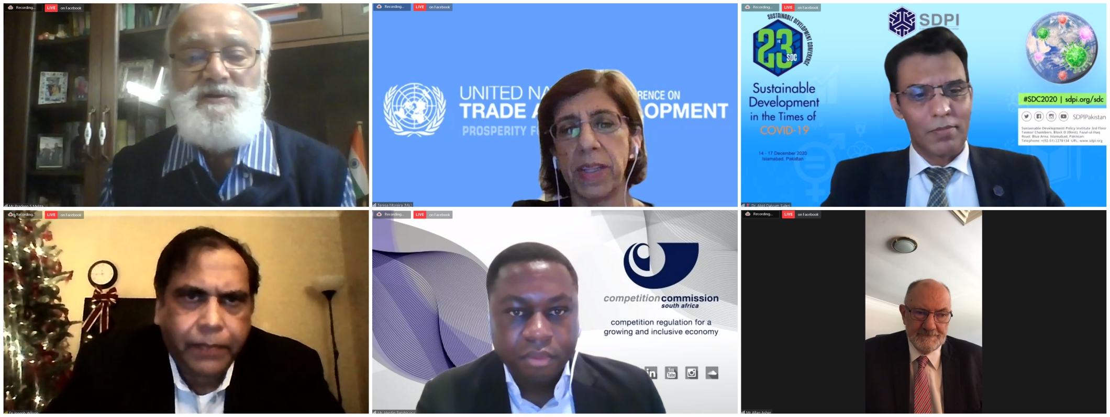
Glimpses
CUTS International and the Sustainable Development Policy Institute co-hosted a webinar on “Access to Healthcare and Competition Policy” on 16th December. Webinar details can be accessed here.

Slide 28
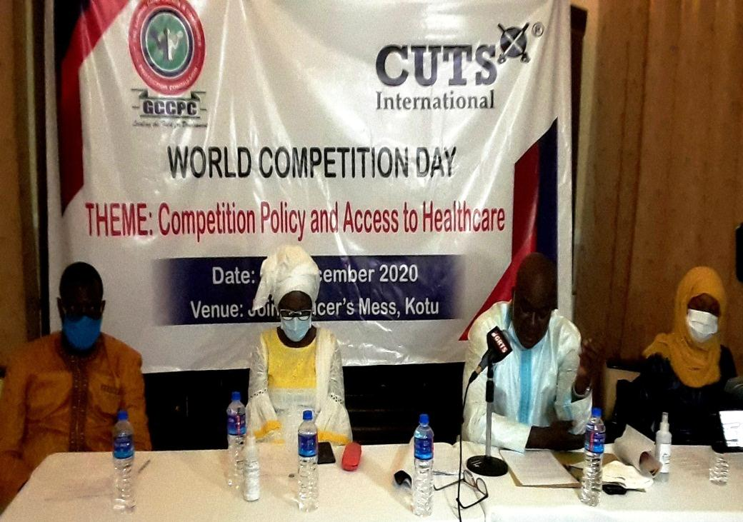
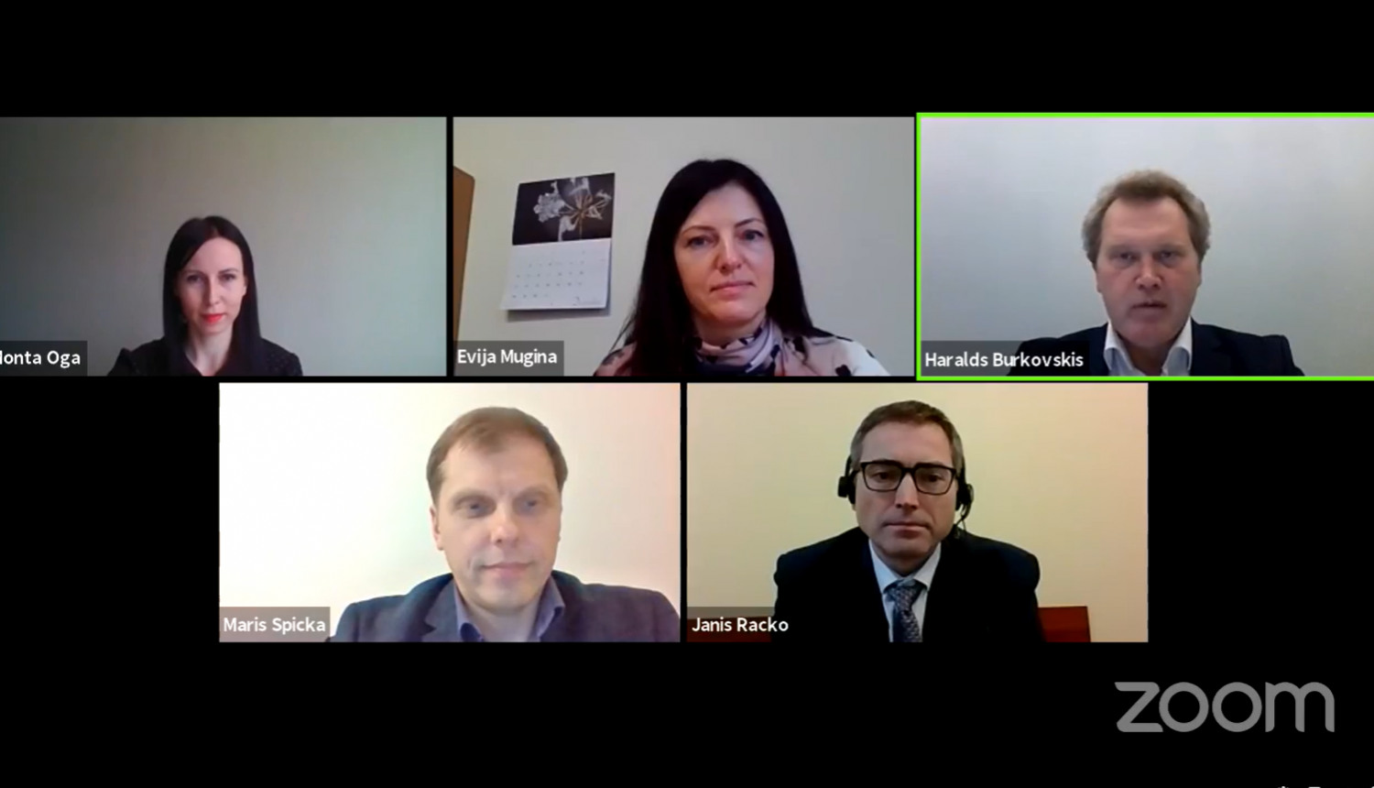
Glimpses
Gambia Competition and Consumer Protection Commission organised a Press Conference to commemorate WCD on the theme “Competition Policy and Access to Healthcare”.
On 4th December, Competition Council of Latvia, in cooperation with the Procurement Monitoring Bureau, held a discussion "Contact Point: Competition" on the topic of public procurement.

Slide 29
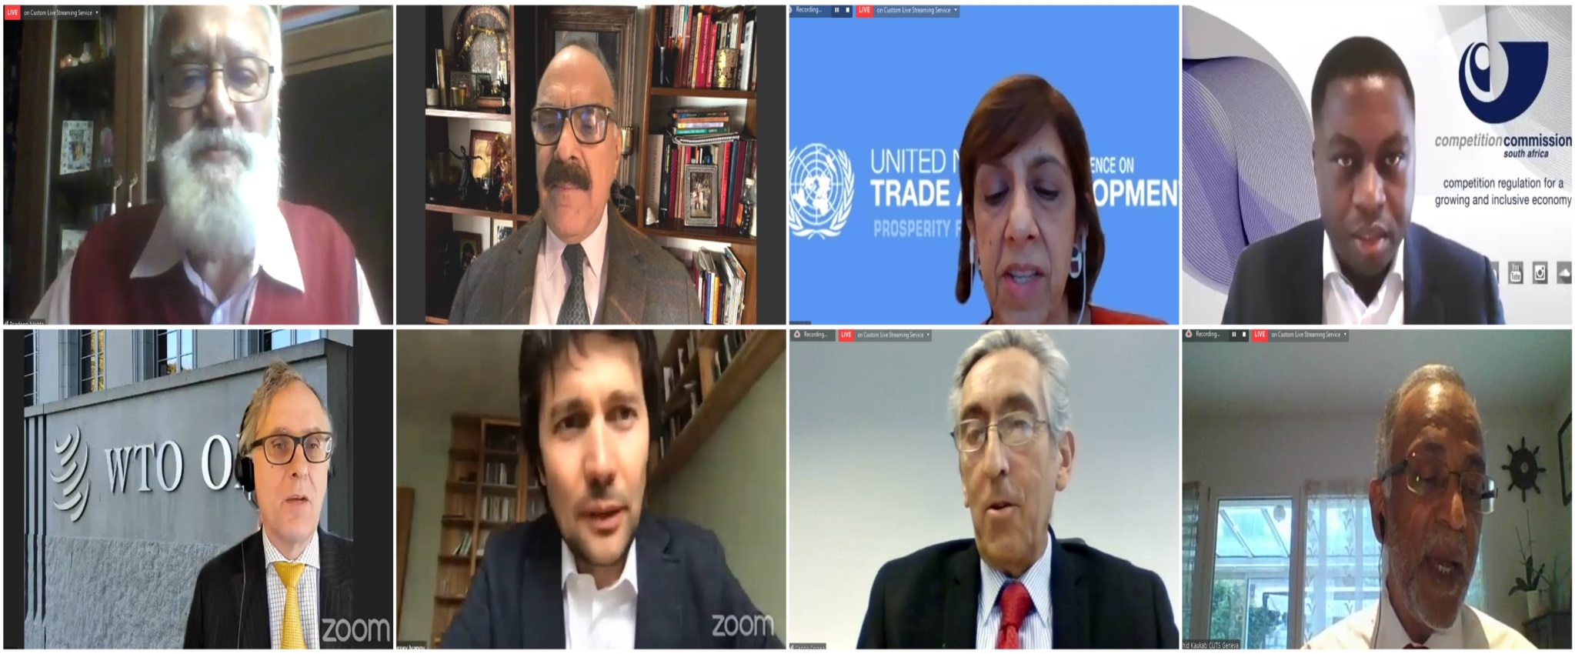
Glimpses
CUTS International and CUTS Institute for Regulation & Competition organised a webinar on “Access to Healthcare and Competition Policy” on 4th December. Webinar details can be accessed here.

Slide 30
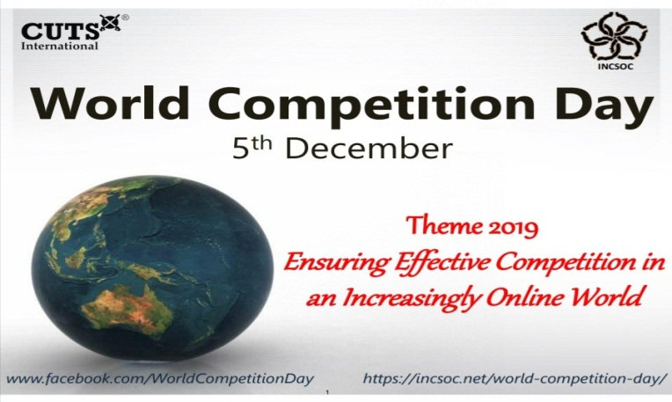
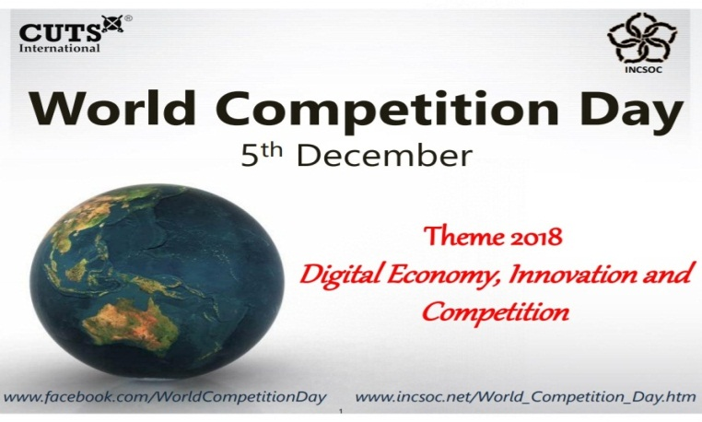
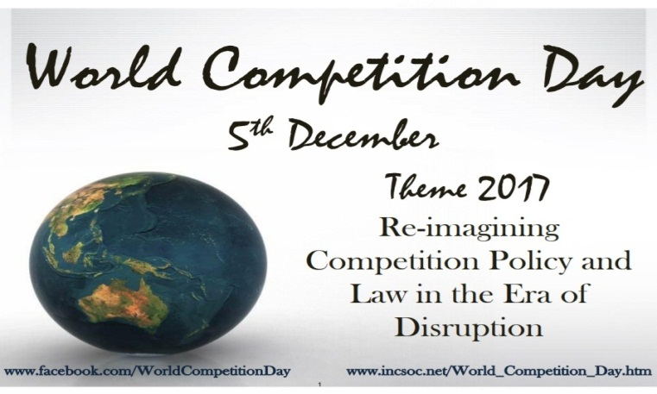
CUTS Compendiums…. since 2011

Slide 31
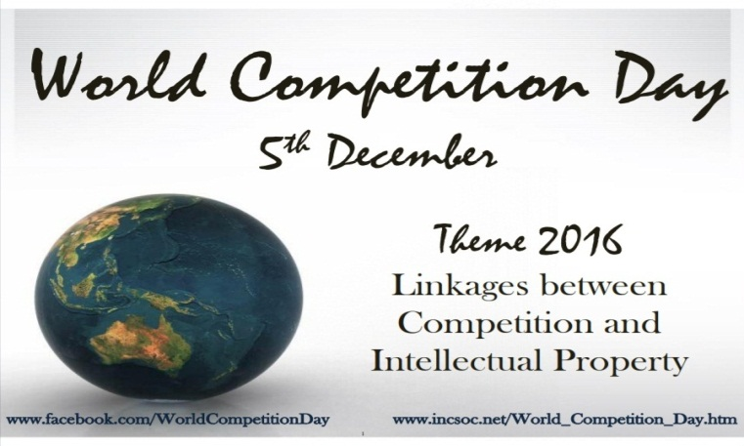
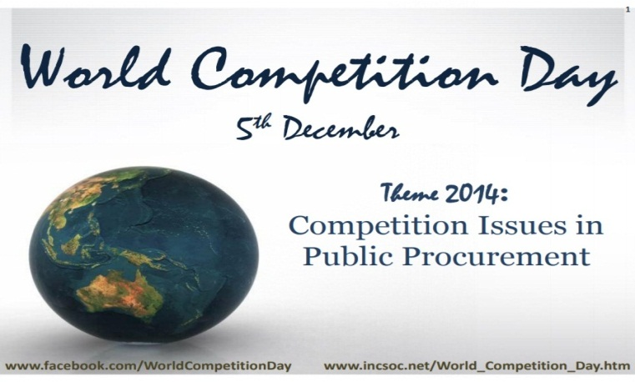
CUTS Compendiums…. since 2011

Slide 32
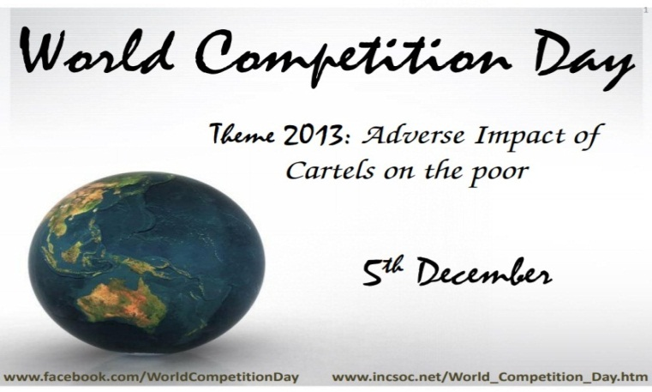
CUTS Compendiums…. since 2011

Slide 33
CUTS Compendiums…. since 2011
Special Edition consists of selected articles written by renowned experts…

Slide 34
Thank You
REQUEST FOR SUGGESTIONS: THEME FOR 2021
Suggestions are welcome for the next year’s theme (i.e. 5th December 2021)
For further information & suggestions, please contact:
Ujjwal Kumar, ujk@cuts.org | Akshay Sharma, aks@cuts.org

