Slide 1
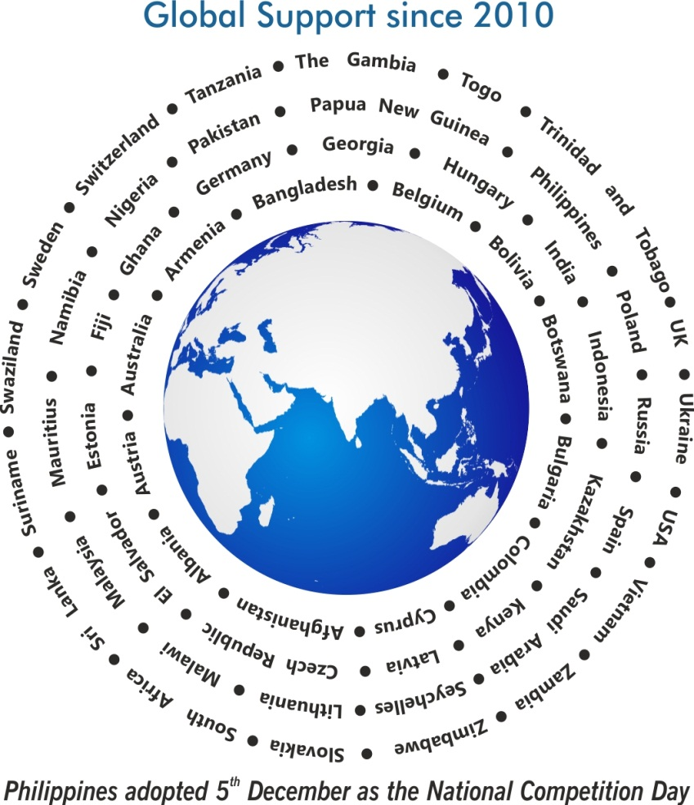
Theme
Competition Policy for an Inclusive and Resilient Economy

Slide 2
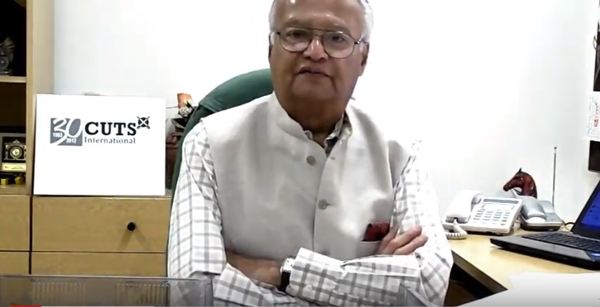
Why World Competition Day?
Pradeep S Mehta
Secretary General, CUTS International

Slide 3
Themes… since 2010
2010 International Air-transport Cartels and its Impact on Developing Countries
2011 Cartels and their Harmful Effects on Consumers
2012 & 2013 Adverse Impact of Cartels on the Poor
2014 & 2015 Competition Issues in Public Procurement
2016 Linkages between Competition and Intellectual Property
2017 Re-imagining Competition Policy and Law in the Era of Disruption
2018 Digital Economy, Innovation and Competition
2019 Ensuring Effective Competition in an Increasingly Online World
2020 Competition Policy and Access to Healthcare
2021 Competition Policy for an Inclusive and Resilient Economy

Slide 4
Support from Countries... since 2010
Competition agencies expressed support towards a formal adoption of the Day
Competition Promotion and Consumer Protection Directorate, Afghanistan
Albanian Competition Authority, Albania
The State Commission for the Protection of Economic Competition of Armenia
Australian Competition & Consumer Commission
Federal Competition Authority, Austria

Slide 5
Support from Countries... since 2010
Competition agencies expressed support towards a formal adoption of the Day
Competition Commission of Bangladesh
The European Commission - Directorate-General for Competition
Competition and Consumer Authority, Botswana
Commission on Protection of Competition, Bulgaria
Superintendence of Industry and Commerce, Colombia

Slide 6
Support from Countries... since 2010
Competition agencies expressed support towards a formal adoption of the Day
Commission for the Protection of Competition, Cyprus
The Office for the Protection of Competition, Czech Republic
Competition Superintendence (SC), El Salvador
Estonian Competition Authority
Fiji Commerce Commission, Fiji

Slide 7
Support from Countries... since 2010
Competition agencies expressed support towards a formal adoption of the Day
Gambia Competition Commission, Gambia
Competition Agency of Georgia
Bundeskartellamt, Germany
The Hungarian Competition Authority (GVH), Hungary
Fair Trading Commission, Jamaica

Slide 8
Support from Countries... since 2010
Competition agencies expressed support towards a formal adoption of the Day
Competition Protection Agency, Republic of Kazakhstan
Competition Authority of Kenya
Competition Council, Republic of Latvia
Competition Council of the Republic of Lithuania
Competition and Fair Trading Commission, Malawi

Slide 9
Support from Countries... since 2010
Competition agencies expressed support towards a formal adoption of the Day
COMESA Competition Commission, Malawi
Competition Commission of Mauritius
Authority for Fair Competition and Consumer Protection of Mongolia
Namibian Competition Commission, Namibia
The Commerce Commission, New Zealand

Slide 10
Support from Countries... since 2010
Competition agencies expressed support towards a formal adoption of the Day
Federal Competition and Consumer Protection Commission, Nigeria
Competition Commission of Pakistan
Independent Consumer and Competition Commission, Papua New Guinea
Philippines adopted 5th December as a National Competition Day
Office of Competition and Consumer Protection (UOKiK), Poland

Slide 11
Support from Countries... since 2010
Competition agencies expressed support towards a formal adoption of the Day
Federal Antimonopoly Service, Russia
General Authority for Competition, Saudi Arabia
Fair Trading Commission, Seychelles
Antimonopoly Office of the Slovak Republic, Slovakia
National Commission of Markets and Competition (CNMC), Spain

Slide 12
Support from Countries... since 2010
Competition agencies expressed support towards a formal adoption of the Day
Competition Tribunal, South Africa
Competition Commission South Africa
Consumer Affairs Authority, Sri Lanka
Eswatini Competition Commission, Swaziland
Swedish Competition Authority (KONKURRENSVERKET)

Slide 13
Support from Countries... since 2010
Competition agencies expressed support towards a formal adoption of the Day
Swiss Competition Commission (COMCO)
Fair Competition Commission, Tanzania
Trinidad and Tobago Fair Trading Commission
Trade Competition Commission of Thailand
The Antimonopoly Committee of Ukraine

Slide 14
Support from Countries... since 2010
Competition agencies expressed support towards a formal adoption of the Day
Office of Fair Trading, United Kingdom
Vietnam Competition Authority, Vietnam
Competition and Consumer Protection Commission, Zambia
Competition and Tariff Commission, Zimbabwe

Slide 15
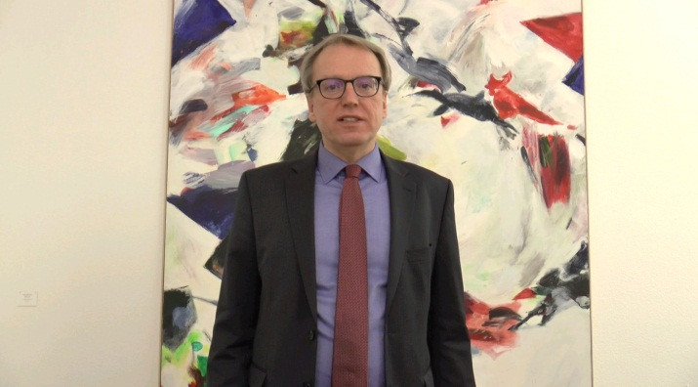
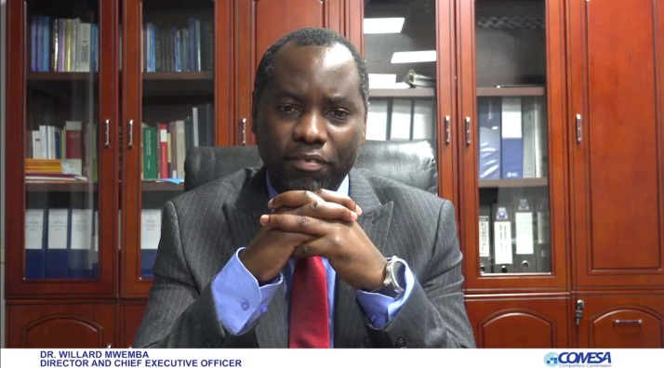
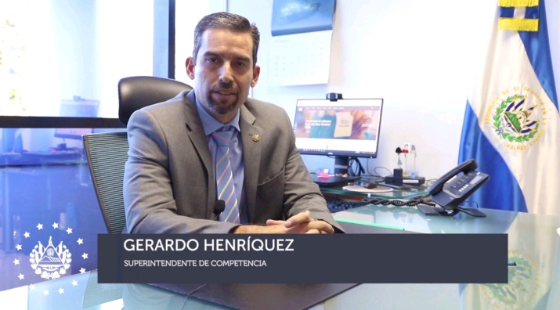
‘Videos’ expressing support to adopt WCD
Organisation for Economic Co-operation and Development (OECD)
Swiss Competition Commission
COMESA Competition Commission
Competition Superintendence
El Salvador

Slide 16
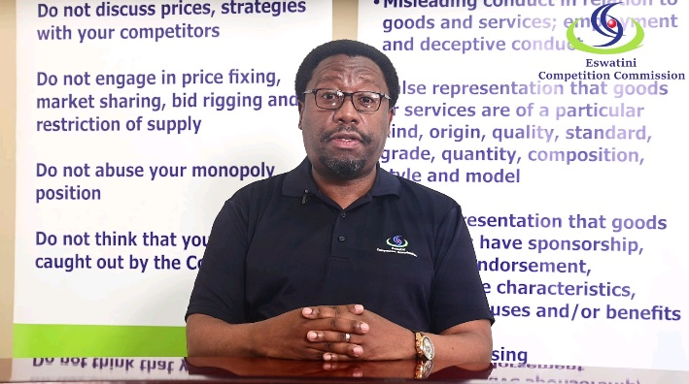
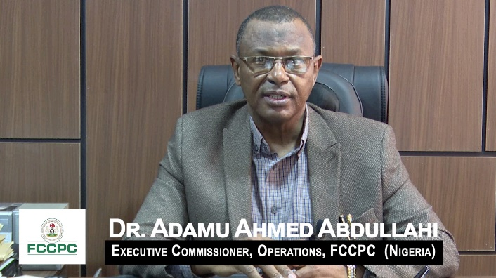
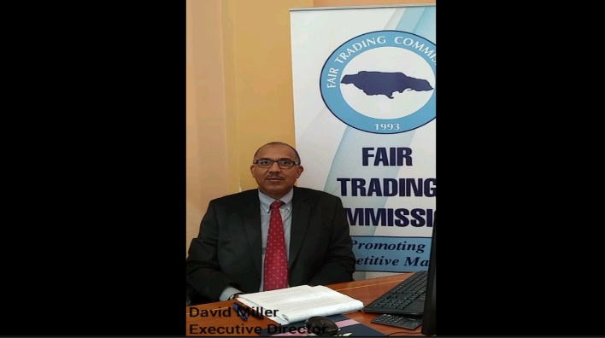
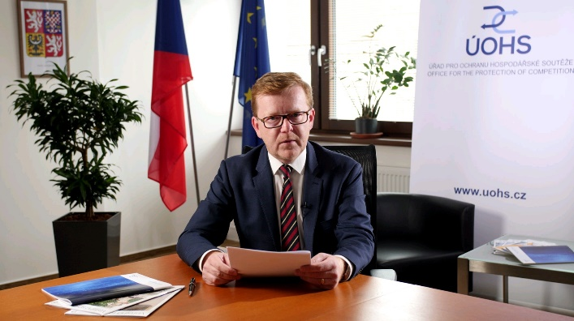
‘Videos’ expressing support to adopt WCD
Eswatini Competition Commission
Federal Competition and Consumer Protection Commission, Nigeria
Fair Trading Commission, Jamaica
Office for the Protection of Competition, Czech Republic

Slide 17
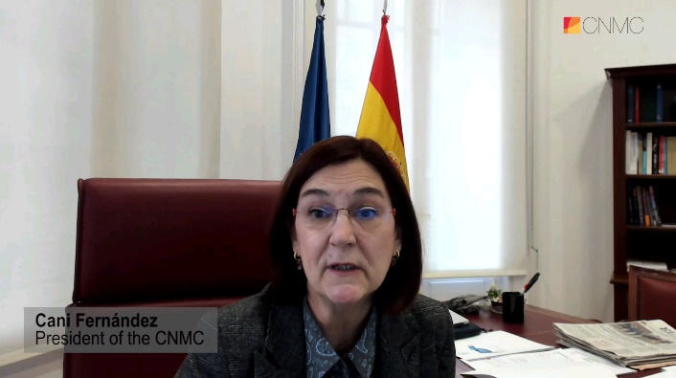
‘Videos’ expressing support to adopt WCD
Trade Competition Commission of Thailand
Competition Authority of Kenya
Fair Trading Commission, Seychelles
Spanish National Commission On Markets And Competition (CNMC)

Slide 18
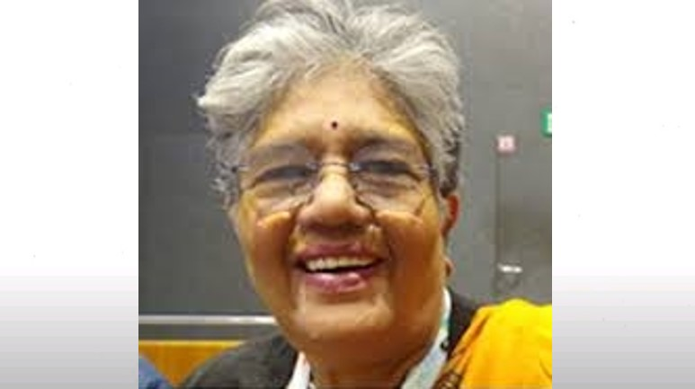
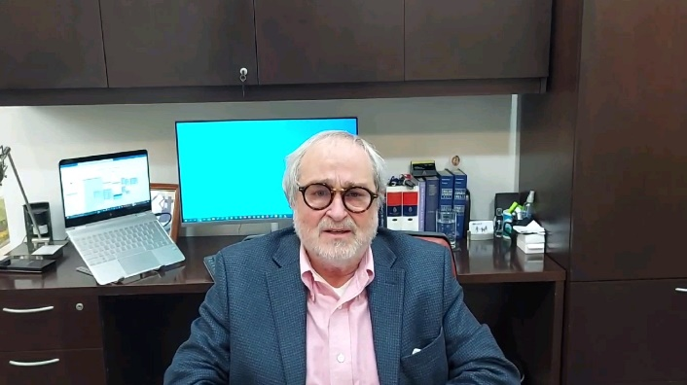
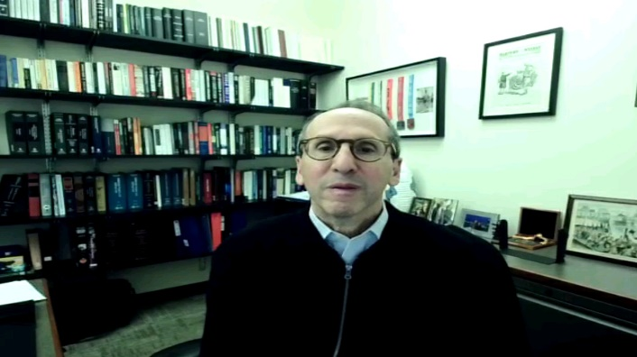
‘Videos’ expressing support to adopt WCD
Deutsche Gesellschaft für Internationale
Zusammenarbeit (GIZ)
Geeta Gouri
Former Member, CCI, India
Gabriel Ibarra Pardo
Ibarra Abogados, Colombia
Spencer Weber Waller
Professor, Loyola University Chicago

Slide 19
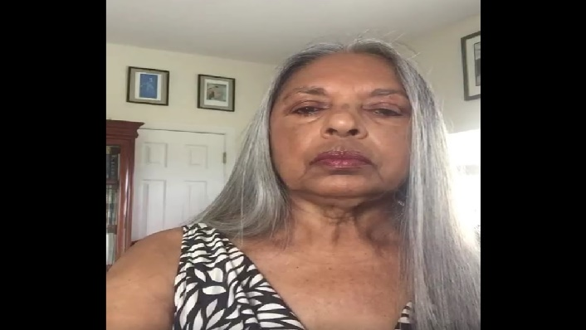
‘Videos’ expressing support to adopt WCD
Taimoon Stewart
University of West Indies

Slide 20
‘Actions’ taken around the world…2020
Media/Social Media | Country
The ACCC celebrates World Competition Day LinkedIn, December 05, 2021 | Australia
World Competition Day 2021: Towards an Inclusive and Resilient Economy December 05, 2021 CCA Press Release Facebook | Botswana
Office for the Protection of Competition celebrates the World Competition Day December 02, 2021 | Czech Republic
Competition policy required to aid government efforts to revive economy through MSMEs: CIRC Chairman KNN India, December 08, 2021 | India

Slide 21
‘Actions’ taken around the world…2020
Media/Social Media | Country
India must revisit its 2011 Competition Policy draft. EU, Australia, and Japan are ahead By Arvind Mayaram, Garima Sodhi and Bhaavi Agrawal The Print, December 09, 2021 | India
FTC Promoting Competition Policy for an Inclusive and Resilient Economy Ministry of Industry Investment & Commerce, December 19, 2021 The FTC’s message for World Competition Day 2021 FTC, December 06, 2021 FTC promoting competition policy for an inclusive and resilient economy December 05, 2021 FTC Press Release The Gleaner | Jamaica

Slide 22
‘Actions’ taken around the world…2020
Media/Social Media | Country
FTC Commemorate World Competition Day November 29, 2021 | Jamaica
Competition Authority of Kenya celebrates World Competition Day Twitter, December 05, 2021 Balancing small firms’ growth, competition Business Daily, December 06, 2021 Institute of Economic Affairs commemorate World Competition Day YouTube, December 03, 2021 | Kenya
Drawing contest for children “Competition - the cornerstone of development” Facebook, December 06, 2021 | Latvia

Slide 23
‘Actions’ taken around the world…2020
Media/Social Media | Country
The Competition Council discusses the involvement of the state and local governments in commercial activities with cooperation partners Competition Council Press Release, December 20, 2021 Competition Council organised a campaign “Most absurd obstacle to the competition” October – November 2021 | Latvia
Lithuanian Competition Council (KT) supports the World Competition Day LinkedIn, December 05, 2021 | Lithuania
Commemoration of World Competition Day, 5th December 2021 CFTC Press Release, December 05, 2021 COMESA Competition Commission supports World Competition Day Twitter, December 06, 2021 | Malawi

Slide 24
‘Actions’ taken around the world…2020
Media/Social Media | Country
CUTS International Celebrates the World Competition Day December 05, 2021 Competition Commission News Facebook Better access to medical products: a revision of certain laws requested Le Defi Media, December 06, 2021 World Competition Day: Eliminate Barriers to Early Access by Putting Intellectual Property Law on the Back Burner Consom'Actor, December 07, 2021 CAP calls for a comprehensive Competition Policy Consumer Advocacy Platform, December 07, 2021 | Mauritius
Digital Poster-making Contest in Celebration of World Competition Day DOJ News, November 17, 2021 | Philippines

Slide 25
‘Actions’ taken around the world…2020
Media/Social Media | Country
Market collusion? Give a signal! - the campaign launched by the President of UOKiK Press Release, December 06, 2021 | Poland
RICA celebrates the World Competition Day Twitter, December 16, 2021 | Rwanda
World Competition Day - A message from Minister Hassan December 05, 2021 Ministry of Finance, Economic Planning and Trade News Facebook | Seychelles
Eswatini Competition Commission celebrates the World Competition Day Twitter, December 05, 2021 | Swaziland

Slide 26
‘Actions’ taken around the world…2020
Media/Social Media | Country
Message from the Chairman of TTFTC - Dr. Ronald Ramkissoon TTFTC News Facebook | Trinidad and Tobago

Slide 27
Glimpses
CUTS International and CUTS Institute for Regulation & Competition (CIRC) jointly organised a webinar on “Competition Policy for an Inclusive and Resilient Economy” on December 06. Webinar details can be accessed here.

Slide 28
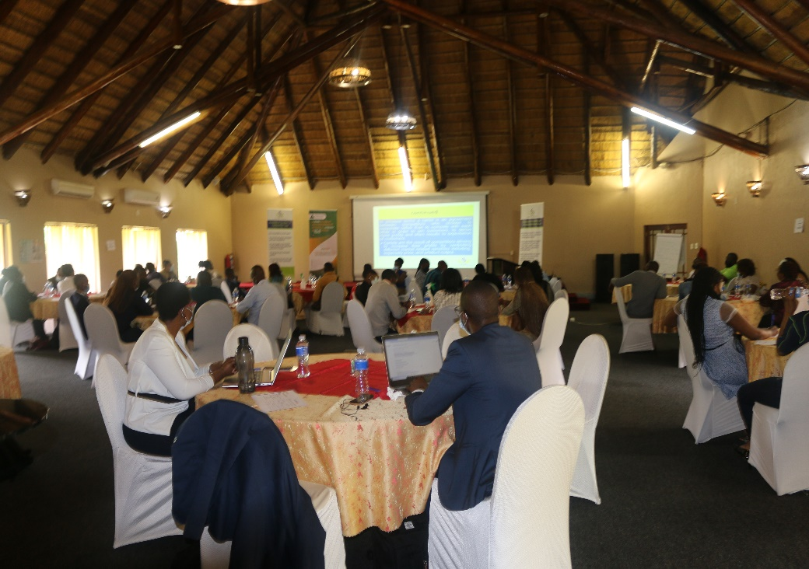
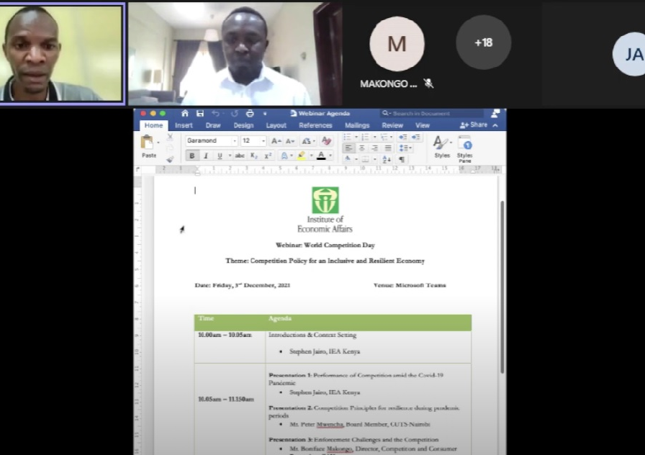
Glimpses
Eswatini Competition Commission through Junior Achievement Eswatini organised a workshop and engaged small businesses on matters of competition and consumer welfare.
Institute of Economic Affairs, Kenya organised a webinar on “Competition Policy for an Inclusive and Resilient Economy” on December 03, 2021.

Slide 29
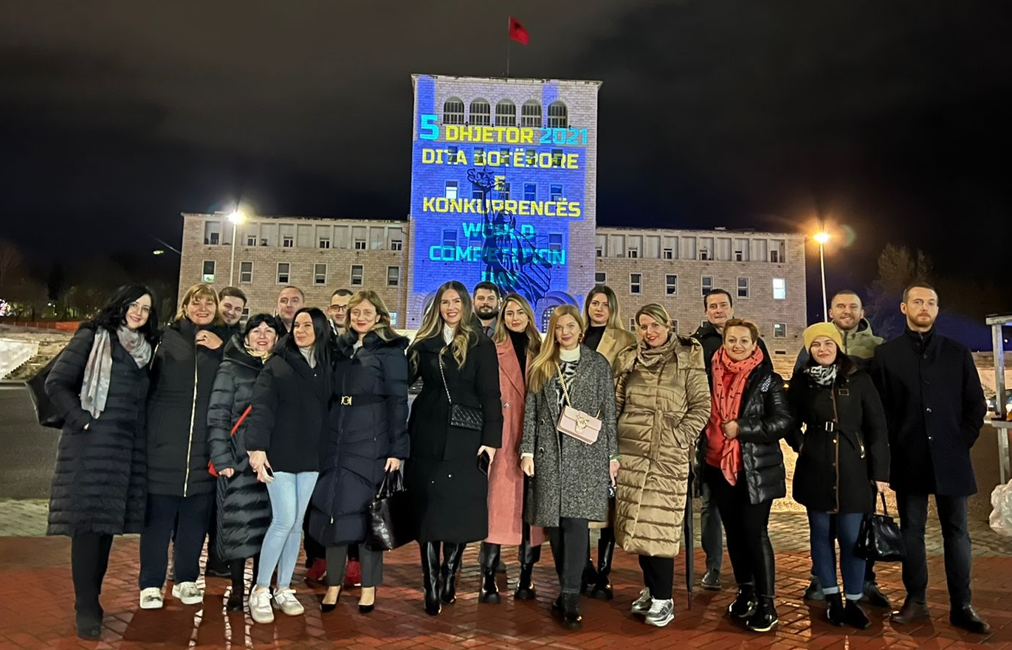
Glimpses
Competition Authority of Albania celebrated the day through a video projection on the University of Tirana’s building.

Slide 30
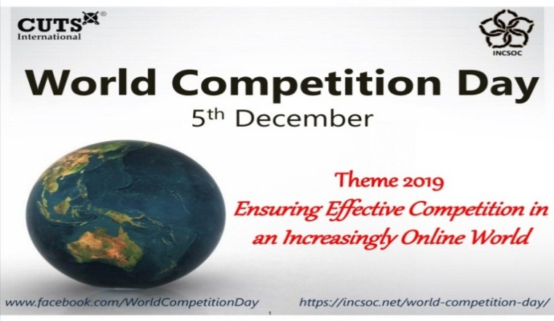
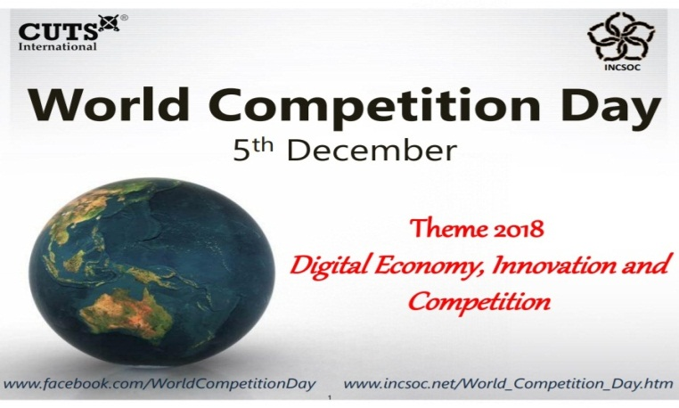
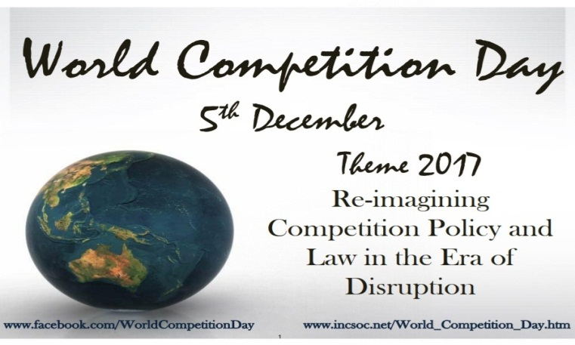
CUTS Compendiums…. since 2011

Slide 31
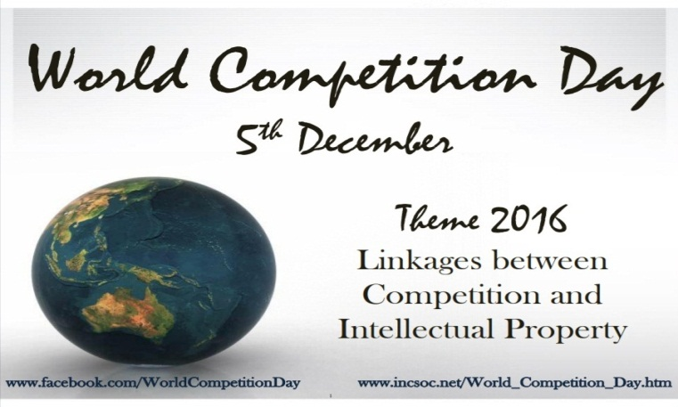
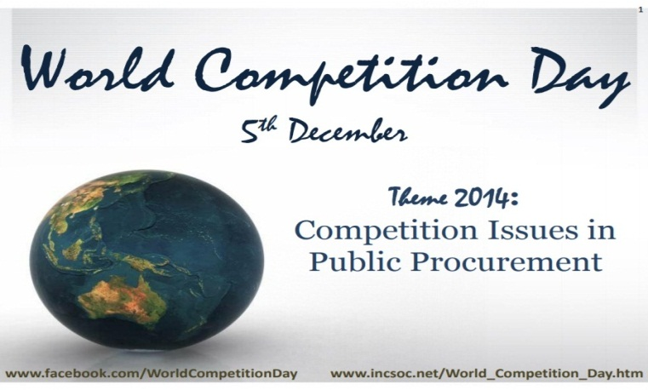
CUTS Compendiums…. since 2011

Slide 32
CUTS Compendiums…. since 2011

Slide 33
CUTS Compendiums…. since 2011
Special Edition consists of selected articles written by renowned experts…

Slide 34
Thank You
Suggestions are welcome for the next year’s theme (i.e. 5th December 2022)
For further information & suggestions, please contact:
Ujjwal Kumar, ujk@cuts.org | Akshay Sharma, aks@cuts.org

