Slide 1


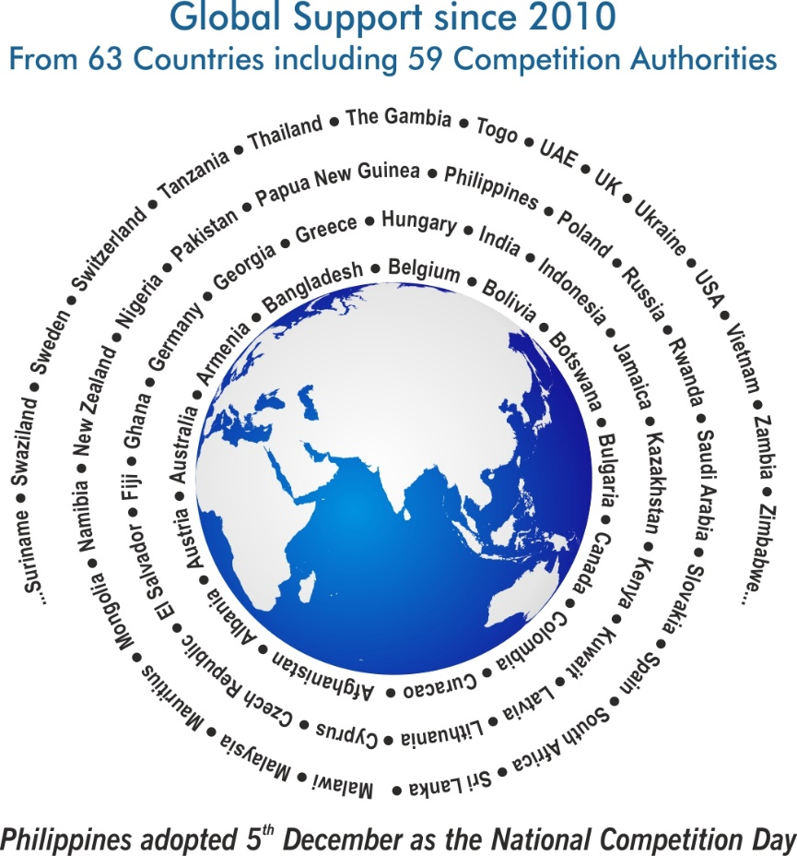
Theme
  Competition Policy and Inequality

Slide 2
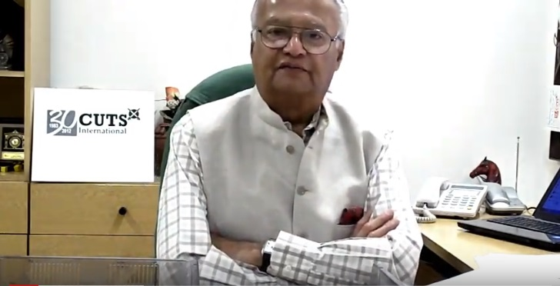
Why World Competition Day?
Pradeep S Mehta
Secretary General, CUTS International

Slide 3
Themes… since 2010
  2010 International Air-transport Cartels and its Impact on Developing Countries
  2011 Cartels and their Harmful Effects on Consumers
  2012 & 2013 Adverse Impact of Cartels on the Poor
  2014 & 2015 Competition Issues in Public Procurement
  2016 Linkages between Competition and Intellectual Property
  2017 Re-imagining Competition Policy and Law in the Era of Disruption
  2018 Digital Economy, Innovation and Competition
  2019 Ensuring Effective Competition in an Increasingly Online World

Slide 4
Themes… since 2010
  2020 Competition Policy and Access to Healthcare
  2021 Competition Policy for an Inclusive and Resilient Economy
  2022 Competition Policy and Climate Change
  2023 Prioritising Socially Sensitive Sectors
  2024 Competition Policy and Inequality

Slide 5





Support from Countries... since 2010
Competition agencies expressed support towards a formal adoption of the Day
Competition Promotion and Consumer Protection Directorate, Afghanistan
  Albanian Competition Authority, Albania
  The State Commission for the Protection of Economic Competition of Armenia
  Australian Competition & Consumer Commission
  Federal Competition Authority, Austria

Slide 6





Support from Countries... since 2010
Competition agencies expressed support towards a formal adoption of the Day
  Competition Commission of Bangladesh
  The European Commission - Directorate-General for Competition
  Competition and Consumer Authority, Botswana
  Commission on Protection of Competition, Bulgaria
  Competition Bureau, Canada

Slide 7





Support from Countries... since 2010
Competition agencies expressed support towards a formal adoption of the Day
  Superintendence of Industry and Commerce, Colombia
  Fair Trade Authority, Curaçao
  Commission for the Protection of Competition, Cyprus
  The Office for the Protection of Competition, Czech Republic
  Competition Superintendence (SC), El Salvador

Slide 8





Support from Countries... since 2010
Competition agencies expressed support towards a formal adoption of the Day
  Estonian Competition Authority
  Fiji Commerce Commission, Fiji
  Gambia Competition Commission, Gambia
  Competition Agency of Georgia
  Bundeskartellamt, Germany

Slide 9





Support from Countries... since 2010
Competition agencies expressed support towards a formal adoption of the Day
  Hellenic Competition Commission, Greece
  The Hungarian Competition Authority (GVH), Hungary
  Fair Trading Commission, Jamaica
  Competition Protection Agency, Republic of Kazakhstan
  Competition Authority of Kenya

Slide 10




Support from Countries... since 2010
Competition agencies expressed support towards a formal adoption of the Day
  Competition Protection Agency, Kuwait
  Competition Council, Republic of Latvia
  Competition Council of the Republic of Lithuania
  Competition and Fair Trading Commission, Malawi
  COMESA Competition Commission joined hand with CUTS in the campaign

Slide 11





Support from Countries... since 2010
Competition agencies expressed support towards a formal adoption of the Day
  Competition Commission of Mauritius
  Authority for Fair Competition and Consumer Protection of Mongolia
  Namibian Competition Commission, Namibia
  The Commerce Commission, New Zealand
  Federal Competition and Consumer Protection Commission, Nigeria

Slide 12





Support from Countries... since 2010
Competition agencies expressed support towards a formal adoption of the Day
  Competition Commission of Pakistan
  Independent Consumer and Competition Commission, Papua New Guinea
  Philippines adopted 5th December as a National Competition Day
  Office of Competition and Consumer Protection (UOKiK), Poland
  Federal Antimonopoly Service, Russia

Slide 13





Support from Countries... since 2010
Competition agencies expressed support towards a formal adoption of the Day
  Rwanda Inspectorate, Competition and Consumer Protection Authority (RICA)
  General Authority for Competition, Saudi Arabia
  Fair Trading Commission, Seychelles
  Antimonopoly Office of the Slovak Republic, Slovakia
  National Commission of Markets and Competition (CNMC), Spain

Slide 14




Support from Countries... since 2010
Competition agencies expressed support towards a formal adoption of the Day
  Competition Tribunal, South Africa
  Competition Commission South Africa
  Consumer Affairs Authority, Sri Lanka
  Eswatini Competition Commission, Swaziland
  Swedish Competition Authority (KONKURRENSVERKET)

Slide 15





Support from Countries... since 2010
Competition agencies expressed support towards a formal adoption of the Day
  Swiss Competition Commission (COMCO)
  Fair Competition Commission, Tanzania
  Taiwan Fair Trade Commission
  Trinidad and Tobago Fair Trading Commission
  Trade Competition Commission of Thailand

Slide 16





Support from Countries... since 2010
Competition agencies expressed support towards a formal adoption of the Day
  The Antimonopoly Committee of Ukraine
  Office of Fair Trading, United Kingdom
  Vietnam Competition Authority
  Competition and Consumer Protection Commission, Zambia
  Competition and Tariff Commission, Zimbabwe

Slide 17
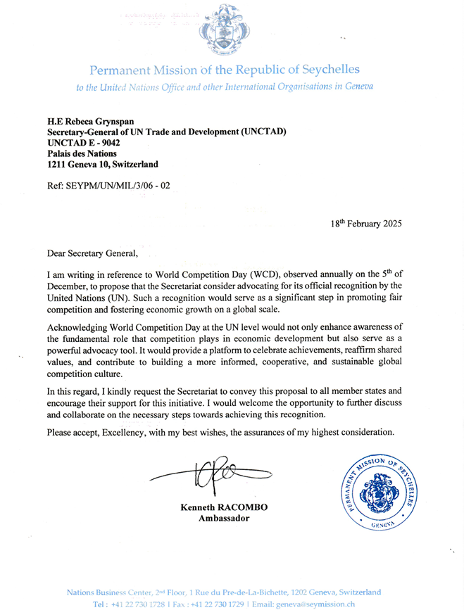
Permanent Mission of the Republic of Seychelles submitted a letter to UN Trade and Development (UNCTAD) for official recognition of WCD on 5th December by the United Nations.

Slide 18

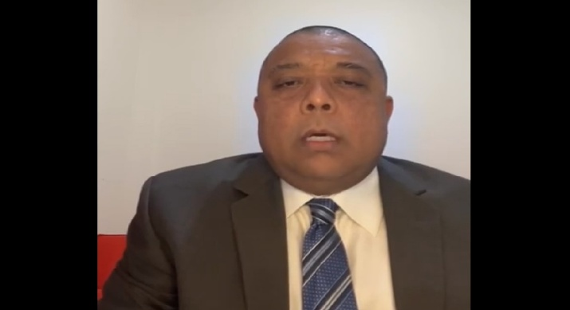
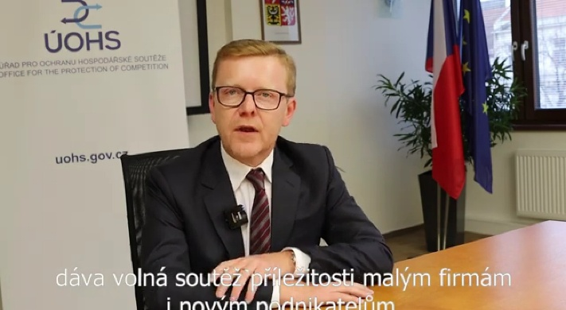
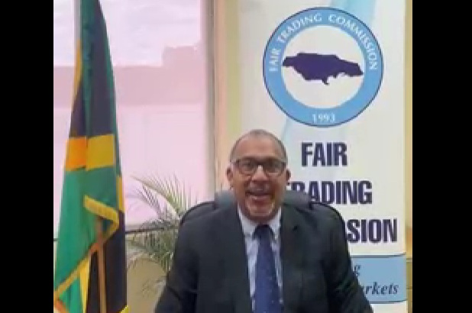
‘Videos’ expressing support to adopt WCD
Hellenic Competition Commission Greece
Trinidad and Tobago Fair Trading Commission
Office for the Protection of
Competition, Czech Republic
Fair Trading Commission
Jamaica

Slide 19
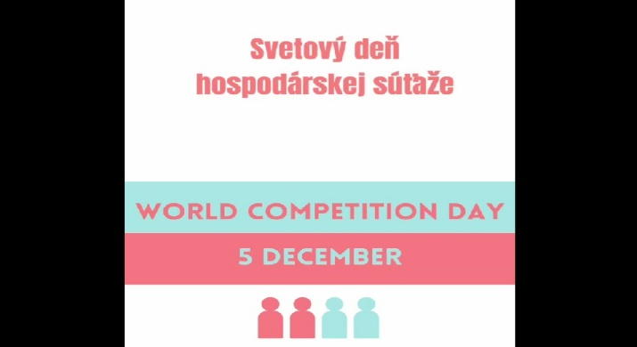
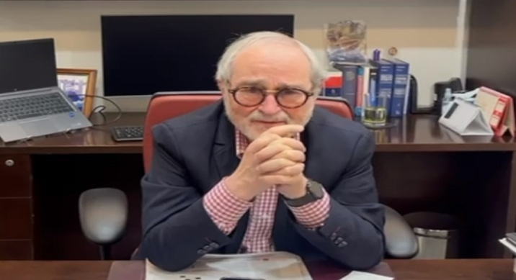
‘Videos’ expressing support to adopt WCD
Antimonopoly Office of the
Slovak Republic
Gabriel Ibarra Pardo
Partner, Ibarra Rimon, Colombia

Slide 20
‘Actions’ taken around the world…2024
Media/Social Media | Country
CCA Celebrates World Competition Day 2024 December 05, 2024 CCA Press Release | Botswana
El Salvador’s Competition Superintendence launched a new mergers course of the e-competencia virtual classroom December 05, 2024 | El Salvador
ESCC Joins World Competition Day Commemoration December 05, 2024 X Eswatini Daily News Africa Press Eswatini Observer | Eswatini
FCCC conducted a survey titled “What Does Competition Mean to You?” to commemorate the World Competition Day December 03, 2024 | Fiji

Slide 21
‘Actions’ taken around the world…2024
Media/Social Media | Country
World Competition Day 2024: Trade, competition, and inequality The Economic Times, December 13, 2024 | Global
Competition Policy Can Moderate Economic Inequality: Pradeep Mehta December 07, 2024 APN News India Education Diary Panel Discussion on ‘Competition Policy and Inequality’ CCI X, December 05, 2024 | India
Competition Policy and Inequality FTC, December 05, 2024 | Jamaica
Levelling the playing field: Competition policy as a driver of equality, inclusion Business Daily, December 04, 2024 | Kenya

Slide 22
‘Actions’ taken around the world…2024
Media/Social Media | Country
This year’s theme for World Competition Day specifically focuses on lowly developed markets including Malawi – CFTC maraviExpress, December 05, 2024 Malawi Commemorates 2024 World Competition Day CFTC Press Release, December 04, 2024 Malawi to observe World Competition Day Leyman Publications, December 06, 2024 | Malawi
Namibian Competition Commission commemorated World Competition Day NBC Digital News, December 05, 2024 YouTube Facebook X Instagram World Competition Day Desert FM 95.3, December 02, 2024 | Namibia

Slide 23
‘Actions’ taken around the world…2024
Media/Social Media | Country
Streamsowers & Köhn celebrating World Competition Day 2024 Instagram, December 05, 2024 | Nigeria
World Competition Day: CCP Discusses Progress and Challenges in Market Integrity December 05, 2024 The Azb UrduPoint Network CCP hosts media workshop to mark World Competition Day Mettis Link News, December 05, 2024 CCP identifies 125 cases of market abuse, strengthens efforts for fair competition Profit Pakistan Today, December 05, 2024 World Competition Day marked: CCP lauds minister’s role for promoting fair competition, regulating markets, fostering best practices Business Recorder, December 06, 2024 | Pakistan

Slide 24
‘Actions’ taken around the world…2024
Media/Social Media | Country
CCP highlights challenges in promoting market integrity on ‘World Competition Day’ The News, December 06, 2024 | Pakistan
ICCC Commemorates World Competition Day 2024 December 05, 2024 ICCC Public Notice Facebook | Papua New Guinea
PCC joins global effort to combat inequality through competition policy PCC Press Release, December 05, 2024 | Philippines
The Competition Commission South Africa celebrates World Competition Day LinkedIn, December 05, 2024 | South Africa
The Minister of Industry and Trade participates in the Climax of World Competition Day 2024 FTC, December 05, 2024 | Tanzania

Slide 25
‘Actions’ taken around the world…2024
Media/Social Media | Country
The Trinidad and Tobago Fair Trading Commission joins the global community in commemorating World Competition Day LinkedIn, December 05, 2024 | Trinidad and Tobago
CUTS celebrates World Competition Day 2024 CUTS Press Release, December 05, 2024 | Zambia
CTC Zimbabwe commemorates World Competition Day X, November 28, 2024 | Zimbabwe

Slide 26
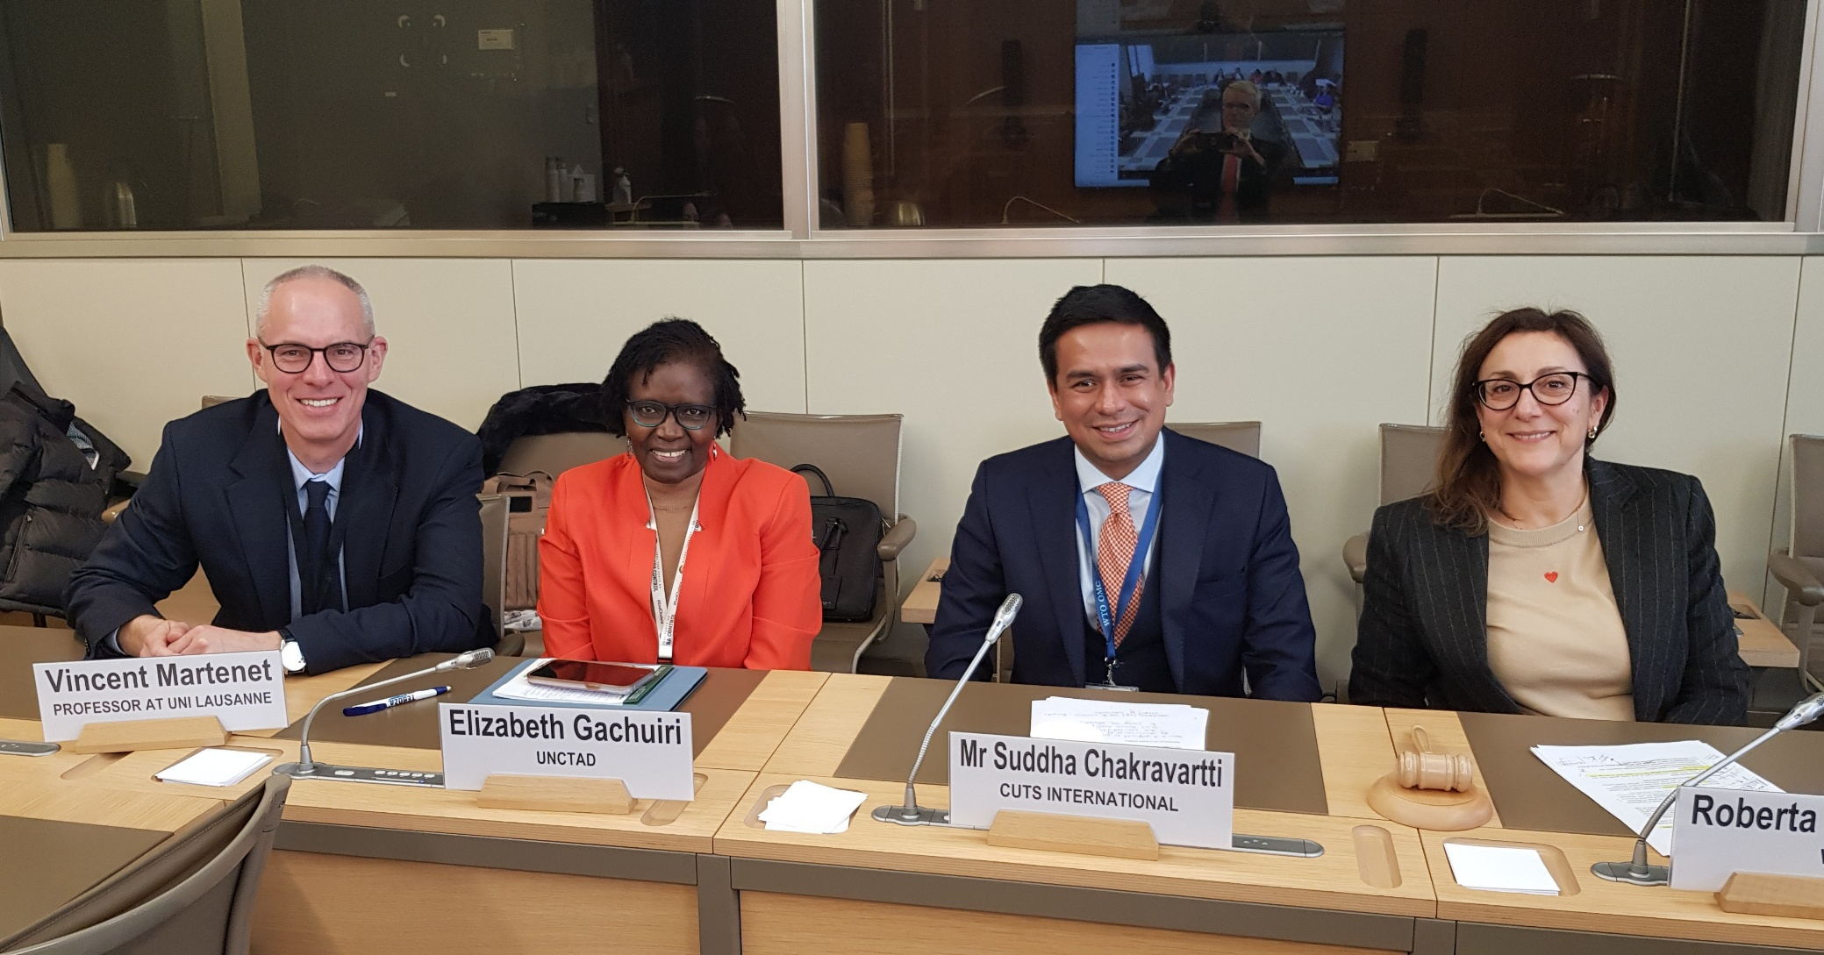
Glimpses
CUTS International, the WTO Secretariats, and UNCTAD’s Competition and Consumer Policies Branch jointly organised a Panel Discussion in Geneva. Details are available here.

Slide 27
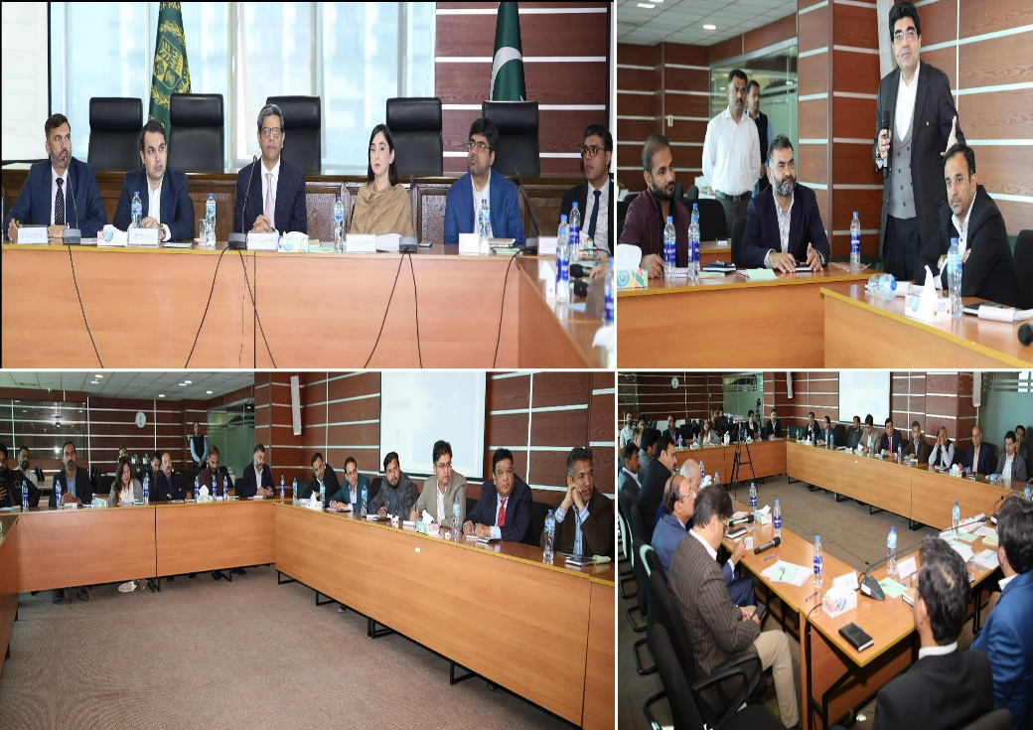
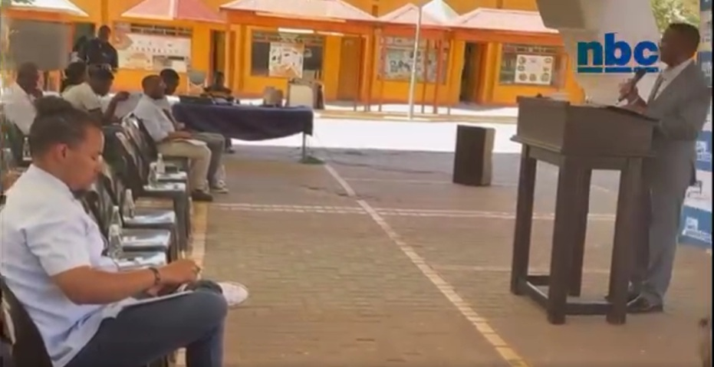
Glimpses
Competition Commission of Pakistan (CCP) hosted a Media Workshop.
Namibian Competition Commission (NaCC) organised an event in Windhoek.

Slide 28
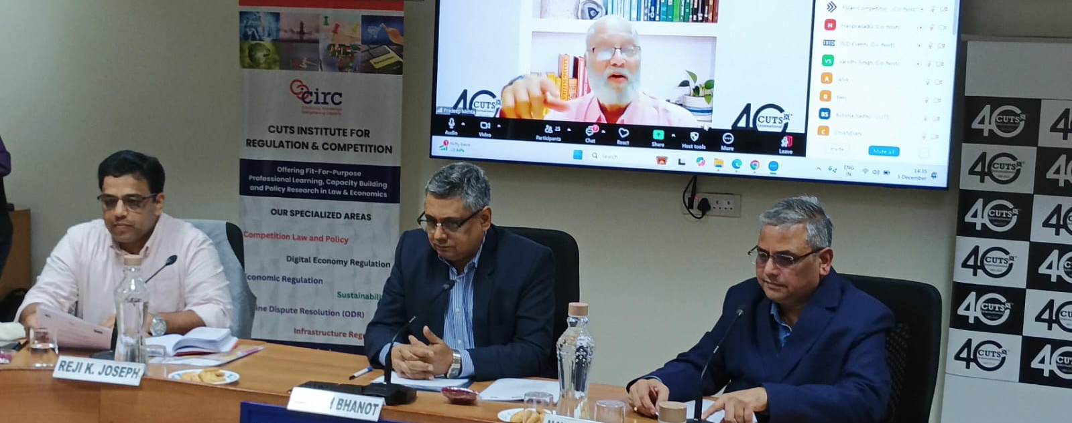
Glimpses
CUTS International, CUTS Institute for Regulation & Competition (CIRC) and Institute for Studies in Industrial Development (ISID) jointly organised a Panel Discussion in New Delhi. Details are available here.

Slide 29




CUTS Compendiums…. since 2011

Slide 30
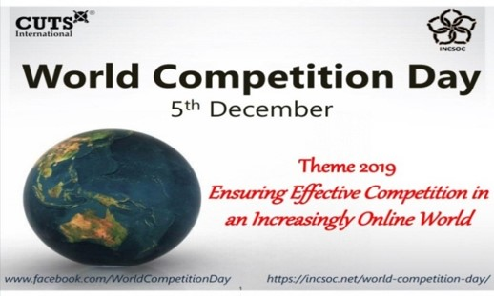
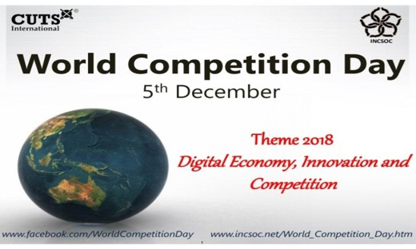
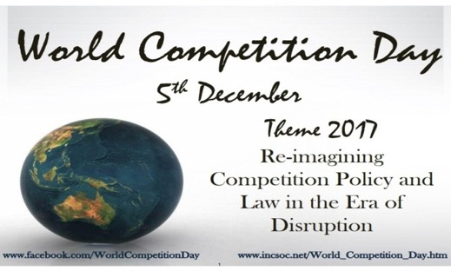
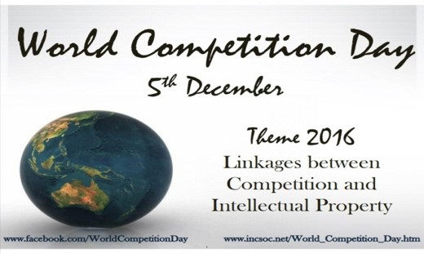
CUTS Compendiums…. since 2011

Slide 31

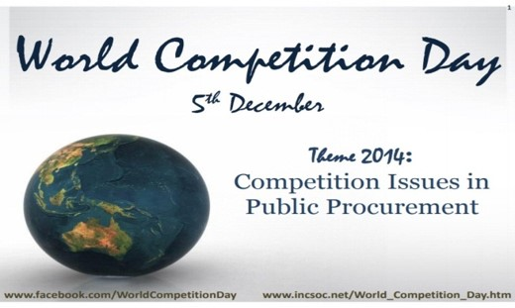
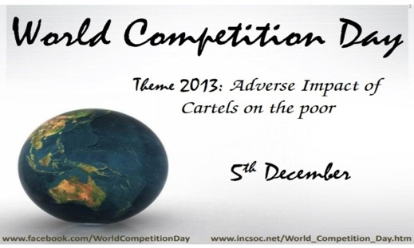

CUTS Compendiums…. since 2011

Slide 32

CUTS Compendiums…. since 2011

Slide 33

CUTS Compendiums…. since 2011
Special Edition consists of selected articles written by renowned experts…

Slide 34



Thank You
Suggestions are welcome for the next year’s theme (i.e. 5th December 2025)
For further information & suggestions, please contact:
Ujjwal Kumar, ujk@cuts.org | Akshay Sharma, aks@cuts.org

