Slide 1

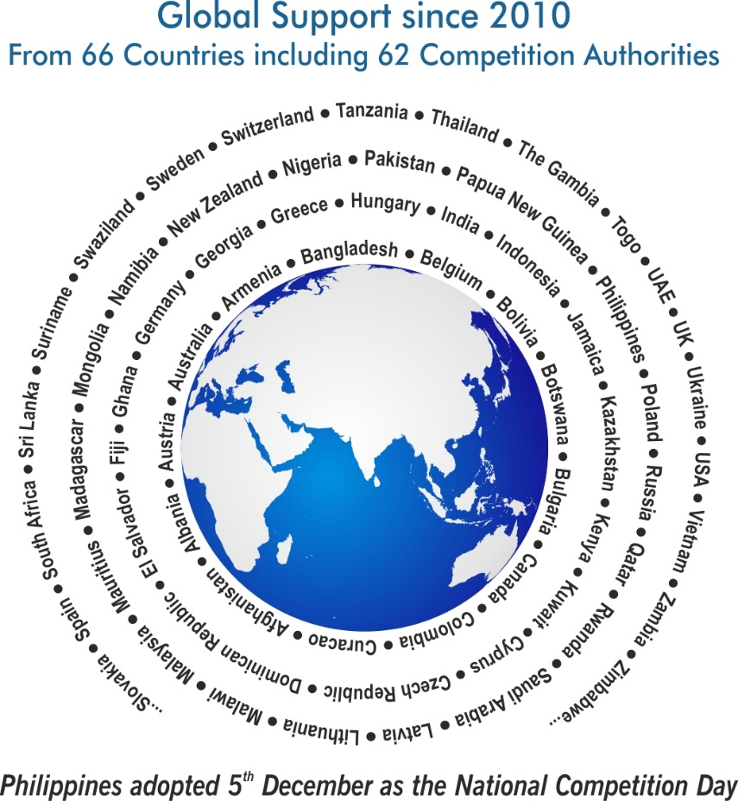
  Artificial Intelligence, Consumers, and Competition Policy

Slide 2
Index
Message from Secretary General, CUTS International | 4
Themes of World Competition Day (2010–2025) | 5-6
Global Support for World Competition Day | 7-19
Republic of Seychelles, ’a letter to UNCTAD’ | 20
Resolution on 9th UN Conference on Competition and Consumer Protection | 21
International Video Messages of Support (2025) | 22-23
Actions Taken Around the World – 2025 | 24-30

Slide 3
Index
Global Glimpses & Key Events | 31-34
CUTS Compendiums (Since 2011) | 35-39
Suggestions for 2026 & Contact Information | 40

Slide 4
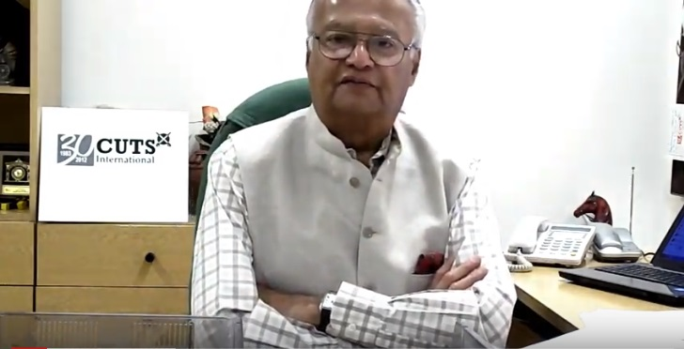
Why World Competition Day?
Video Message From
Pradeep S Mehta
Secretary General, CUTS International

Slide 5
Themes… since 2010
  2010 International Air-transport Cartels and its Impact on Developing Countries
  2011 Cartels and their Harmful Effects on Consumers
  2012 & 2013 Adverse Impact of Cartels on the Poor
  2014 & 2015 Competition Issues in Public Procurement
  2016 Linkages between Competition and Intellectual Property
  2017 Re-imagining Competition Policy and Law in the Era of Disruption
  2018 Digital Economy, Innovation and Competition
  2019 Ensuring Effective Competition in an Increasingly Online World

Slide 6
Themes… since 2010
  2020 Competition Policy and Access to Healthcare
  2021 Competition Policy for an Inclusive and Resilient Economy
  2022 Competition Policy and Climate Change
  2023 Prioritising Socially Sensitive Sectors
  2024 Competition Policy and Inequality
  2025 Artificial Intelligence, Consumers, and Competition Policy

Slide 7





Support from Countries... since 2010
Competition agencies expressed support towards a formal adoption of the Day
Competition Promotion and Consumer Protection Directorate, Afghanistan
  Albanian Competition Authority, Albania
  The State Commission for the Protection of Economic Competition of Armenia
  Australian Competition & Consumer Commission
  Federal Competition Authority, Austria

Slide 8





Support from Countries... since 2010
Competition agencies expressed support towards a formal adoption of the Day
  Competition Commission of Bangladesh
  The European Commission - Directorate-General for Competition
  Competition and Consumer Authority, Botswana
  Commission on Protection of Competition, Bulgaria
  Competition Bureau, Canada

Slide 9





Support from Countries... since 2010
Competition agencies expressed support towards a formal adoption of the Day
  Superintendence of Industry and Commerce, Colombia
  Fair Trade Authority, Curaçao
  Commission for the Protection of Competition, Cyprus
  The Office for the Protection of Competition, Czech Republic
  National Commission for the Defense of Competition, Dominican Republic

Slide 10





Support from Countries... since 2010
Competition agencies expressed support towards a formal adoption of the Day
  Competition Superintendence (SC), El Salvador
  Estonian Competition Authority
  Fiji Commerce Commission, Fiji
  Gambia Competition Commission, Gambia
  Competition Agency of Georgia

Slide 11





Support from Countries... since 2010
Competition agencies expressed support towards a formal adoption of the Day
  Bundeskartellamt, Germany
  Hellenic Competition Commission, Greece
  The Hungarian Competition Authority (GVH), Hungary
  Fair Trading Commission, Jamaica
  Competition Protection Agency, Republic of Kazakhstan

Slide 12





Support from Countries... since 2010
Competition agencies expressed support towards a formal adoption of the Day
  Competition Authority of Kenya
  Competition Protection Agency, Kuwait
  Competition Council, Republic of Latvia
  Competition Council of the Republic of Lithuania
  Competition Council, Madagascar

Slide 13




Support from Countries... since 2010
Competition agencies expressed support towards a formal adoption of the Day
  Competition and Fair Trading Commission, Malawi
  COMESA Competition Commission joined hand with CUTS in the campaign
  Competition Commission of Mauritius
  Authority for Fair Competition and Consumer Protection of Mongolia
  Namibian Competition Commission, Namibia

Slide 14





Support from Countries... since 2010
Competition agencies expressed support towards a formal adoption of the Day
  The Commerce Commission, New Zealand
  Federal Competition and Consumer Protection Commission, Nigeria
  Competition Commission of Pakistan
  Independent Consumer and Competition Commission, Papua New Guinea
  Philippines adopted 5th December as a National Competition Day

Slide 15





Support from Countries... since 2010
Competition agencies expressed support towards a formal adoption of the Day
  Office of Competition and Consumer Protection (UOKiK), Poland
  The Ministry of Commerce and Industry (MOCI), Qatar
  Federal Antimonopoly Service, Russia
  Rwanda Inspectorate, Competition and Consumer Protection Authority (RICA)
  General Authority for Competition, Saudi Arabia

Slide 16




Support from Countries... since 2010
Competition agencies expressed support towards a formal adoption of the Day
  Fair Trading Commission, Seychelles
  Antimonopoly Office of the Slovak Republic, Slovakia
  National Commission of Markets and Competition (CNMC), Spain
  Competition Tribunal, South Africa
  Competition Commission South Africa

Slide 17





Support from Countries... since 2010
Competition agencies expressed support towards a formal adoption of the Day
  Consumer Affairs Authority, Sri Lanka
  Eswatini Competition Commission, Swaziland
  Swedish Competition Authority (KONKURRENSVERKET)
  Swiss Competition Commission (COMCO)
  Fair Competition Commission, Tanzania

Slide 18





Support from Countries... since 2010
Competition agencies expressed support towards a formal adoption of the Day
  Taiwan Fair Trade Commission
  Trinidad and Tobago Fair Trading Commission
  Trade Competition Commission of Thailand
  The Antimonopoly Committee of Ukraine
  Office of Fair Trading, United Kingdom

Slide 19



Support from Countries... since 2010
Competition agencies expressed support towards a formal adoption of the Day
  Vietnam Competition Authority
  Competition and Consumer Protection Commission, Zambia
  Competition and Tariff Commission, Zimbabwe

Slide 20
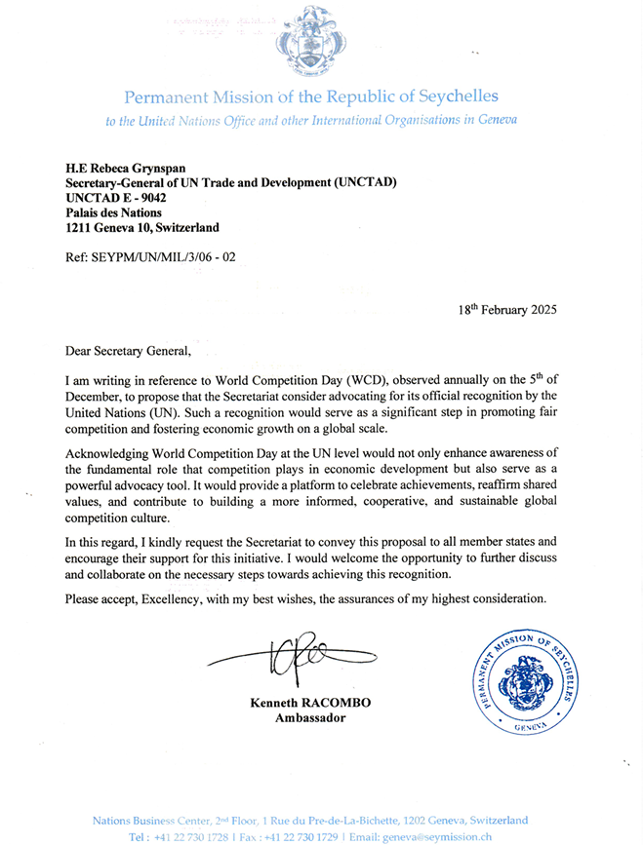
Permanent Mission of the Republic of Seychelles submitted a letter to UN Trade and Development (UNCTAD) for official recognition of WCD on 5th December by the United Nations.

Slide 21
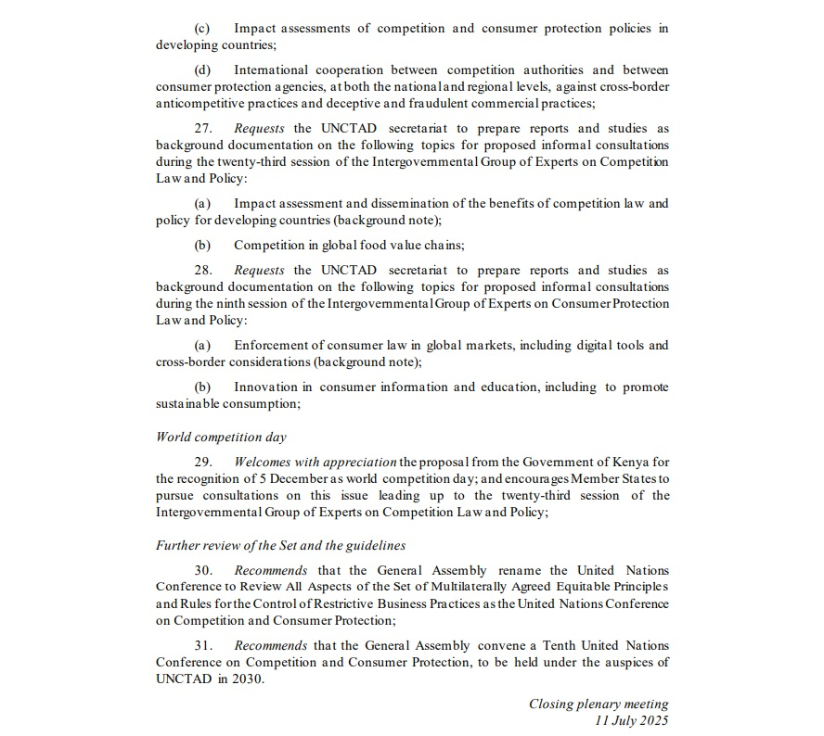
At the 9th United Nations Conference on Competition and Consumer Protection (July 2025), the proposal by Kenya was substantively discussed and a resolution adopted.
Para 29
“Welcomes with appreciation the proposal from the Government of Kenya for the recognition of 5 December as World Competition Day; and encourages Member States to pursue consultations on this issue leading up to the twenty-third session of the Intergovernmental Group of Experts on Competition Law and Policy.”

Slide 22
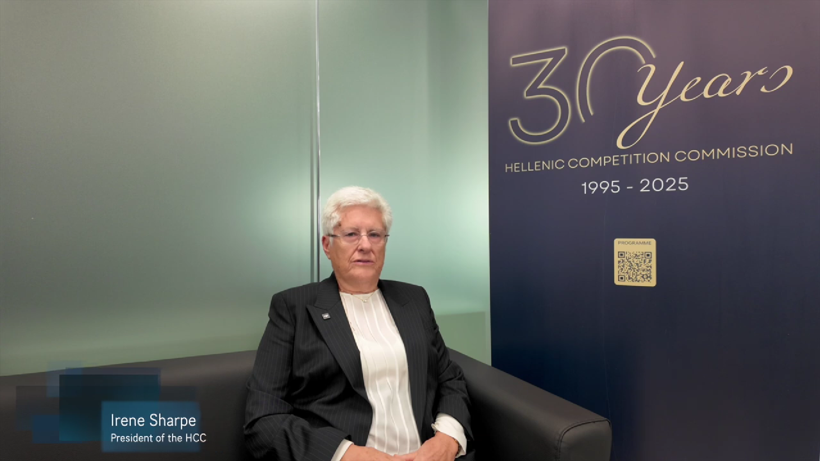
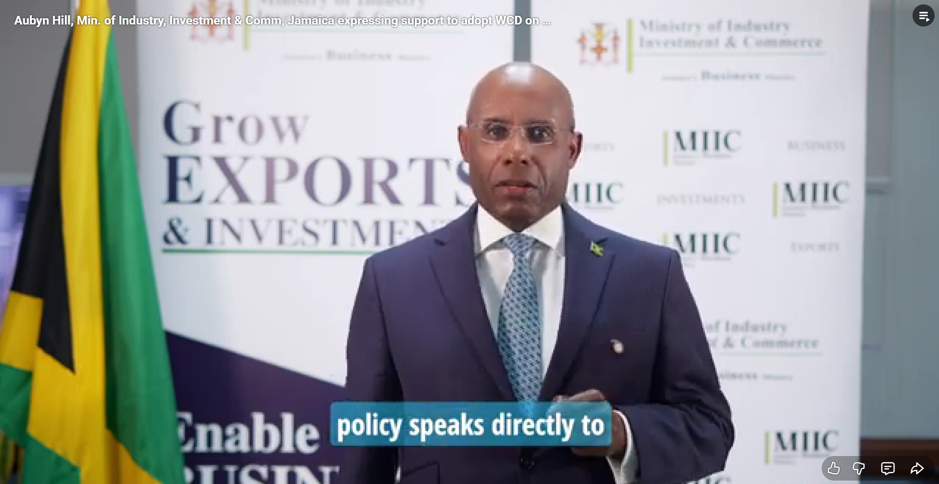

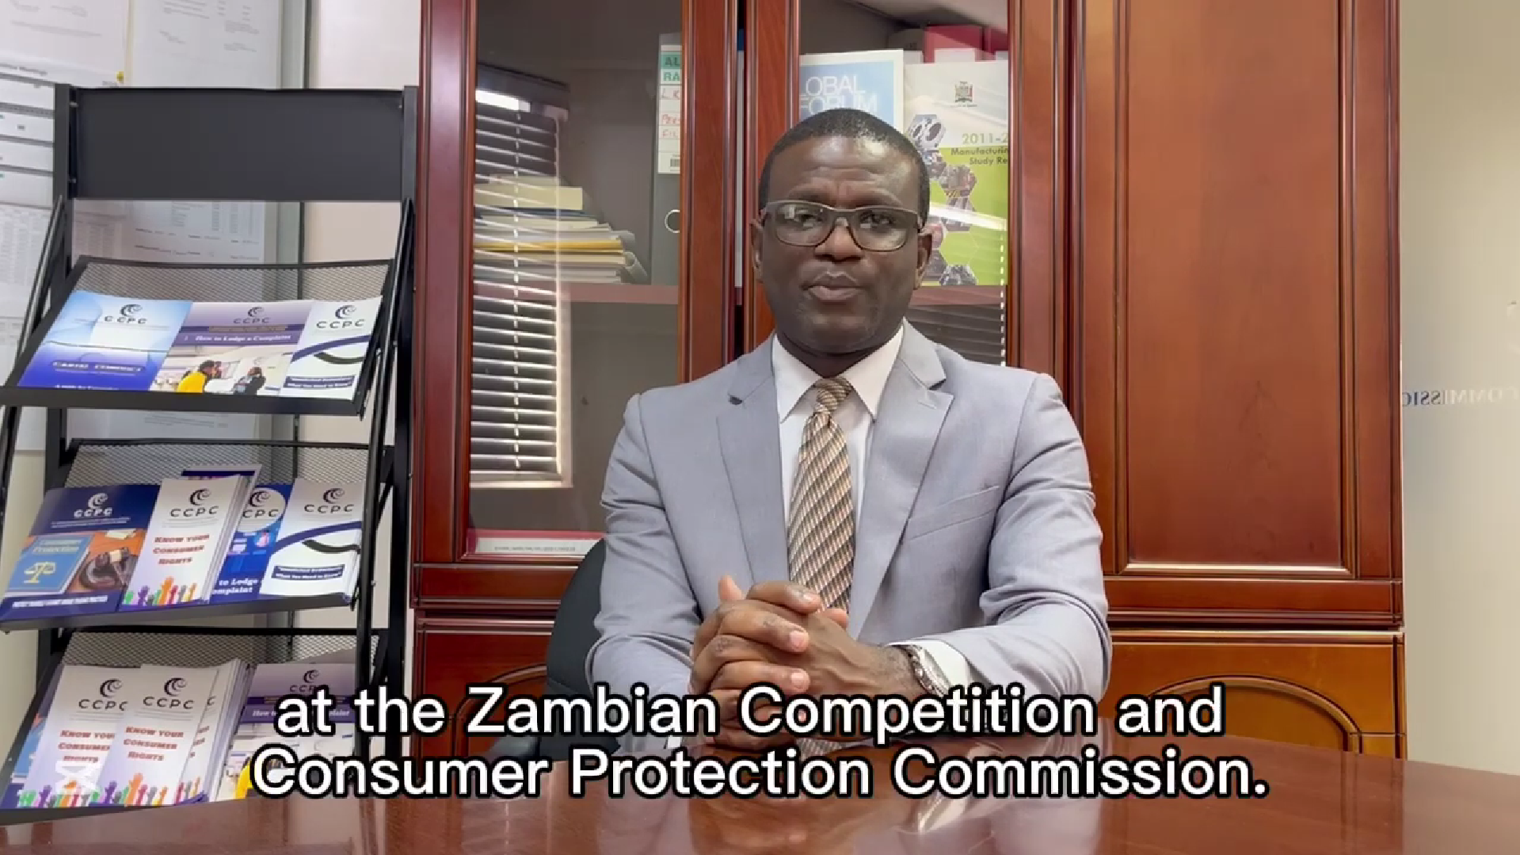
Videos this year expressing support to adopt WCD
Hellenic Competition Commission Greece
Ministry of Industry, Investment & Commerce
Jamaica
Philippine Institute for Development Studies
The Philippines
Competition and Consumer Protection Commission
Zambia

Slide 23
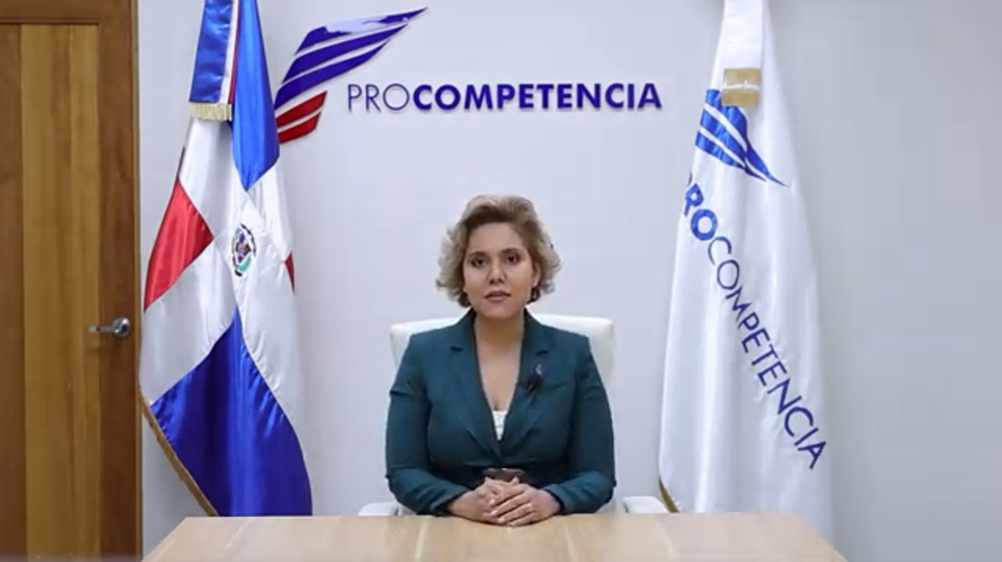


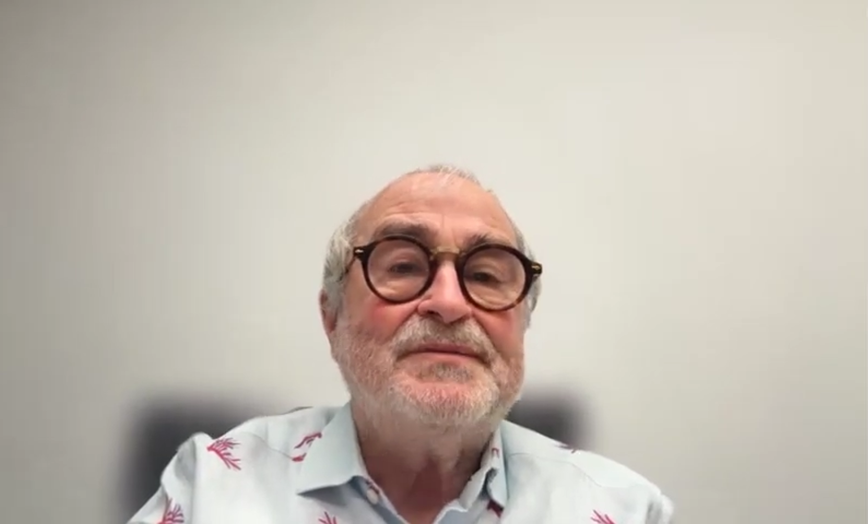
Videos this year expressing support to adopt WCD
National Commission for the Defense of Competition
Dominican Republic
Deutsche Gesellschaft für
Internationale Zusammenarbeit (GIZ) GmbH
Fijian Competition and Consumer Commission
Fiji
Gabriel Ibarra Pardo
Partner, Ibarra Rimon, Colombia

Slide 24
‘Actions’ taken around the world…2025
Media/Social Media | Country
The winners of the competition law essay contest are announced! CAA Press Release, December 08, 2025 | Albania
CCA Celebrates World Competition Day 2025 Facebook, December 05, 2025 | Botswana
AI's Impact on Competition Policy in Fiji December 05, 2025 LinkedIn Facebook | Fiji
GCCPC Marks World Competition Day With Spotlight on AI & Consumer Protection December 12, 2025 Kerr Fatou Media Facebook | Gambia

Slide 25
‘Actions’ taken around the world…2025
Media/Social Media | Country
GIZ proudly reaffirms its commitment to fair business practices Facebook, December 05, 2025 | Germany
CUTS Raises Concern Over Prolonged Delay in Consumer Protection and Competition Law Passage December 07, 2025 Modern Ghana The Chronicle GBC Ghana Online MyjoyOnline | Ghana
COMESA Competition Commission CEO Calls for Stronger Competition Frameworks amid AI Advancements on World Competition Day APN News, December 08, 2025 | Global
Fair Trading Commission’s World Competition Day Message FTC, December 05, 2025 | Jamaica

Slide 26
‘Actions’ taken around the world…2025
Media/Social Media | Country
FTC commemorates World Competition Day December 06, 2025 X Instagram | Jamaica
Global AI market surge: Protecting consumers in the age of algorithms Business Daily, December 03, 2025 | Kenya
Malawi Commemorates World Competition Day CFTC Press Release, December 04, 2025 CFTC to host panel discussion in commemoration of World Competition Day to share insights on the fundamentals, dynamics and implications of AI for developing economies maraviExpress, December 04, 2025 CFTC will join the global community in commemorating the World Competition Day Facebook, December 02, 2025 | Malawi

Slide 27
‘Actions’ taken around the world…2025
Media/Social Media | Country
Malawi Commemorates World Competition Day under the theme Artificial Intelligence, Consumers and Competition Policy Facebook, December 04, 2025 | Malawi
Streamsowers & Köhn celebrating World Competition Day 2025 Facebook, December 05, 2025 | Nigeria
The Philippine Competition Commission (PCC) joins competition authorities worldwide in celebrating World Competition Day December 05, 2025 LinkedIn Facebook | Philippines
MOCI Enhances Investors' Awareness of Competition Principles, Sound Commercial Practices Qatar News Agency, December 08, 2025 | Qatar

Slide 28
‘Actions’ taken around the world…2025
Media/Social Media | Country
FTC joins the global community in celebrating World Competition Day Instagram, December 05, 2025 | Seychelles
Commission’s digital efforts will save SA businesses R1.16bn Sowetan, December 08, 2025 | South Africa
Minister calls for tougher consumer laws as AI gains economy-influence Independent News, December 09, 2025 | Swaziland
FCC warns of emerging AI risks as Tanzania marks competition week The Respondent, December 01, 2025 FCC Commemorated World Competition Day Instagram, December 05, 2025 | Tanzania
World Competition Day 2025: Message from the ED, Bevan Narinesingh TTFTC Press Release, December 05, 2025 | Trinidad and Tobago

Slide 29
‘Actions’ taken around the world…2025
Media/Social Media | Country
CUTS International Lusaka and CCPC Jointly Commemorate World Competition Day 2025 Facebook, December 07, 2025 Consumer protection commission highlights risks of AI for consumers, competition in Zambia December 05, 2025 Zambia Monitor Facebook Burundi's Permanent Representative to COMESA and DG COMESA discussed the Commission's role in monitoring anti-competitive practices X, December 02, 2025 | Zambia
CTC discusses this year's critical theme "Artificial Intelligence, Consumers, and Competition Policy“ ZTNPrime, December 05, 2025 | Zimbabwe

Slide 30
‘Actions’ taken around the world…2025
Media/Social Media | Country
Zimbabwe Marks World Competition Day 2025 December 04, 2025 X Facebook | Zimbabwe

Slide 31
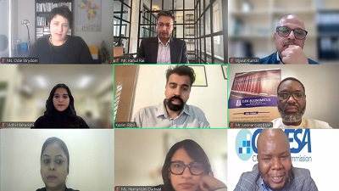
Glimpses
CUTS International, CUTS Institute for Regulation & Competition (CIRC), and the COMESA Competition & Consumer Commission (CCCC) jointly organised a Virtual Panel Discussion. Details are available here.

Slide 32
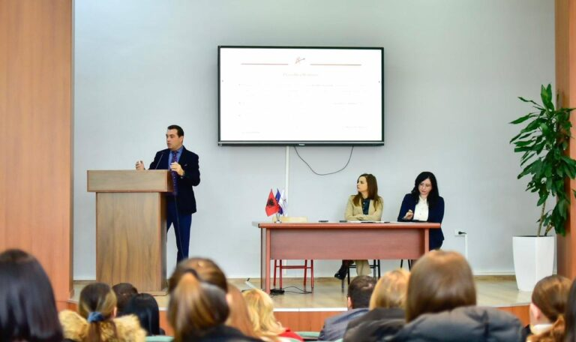
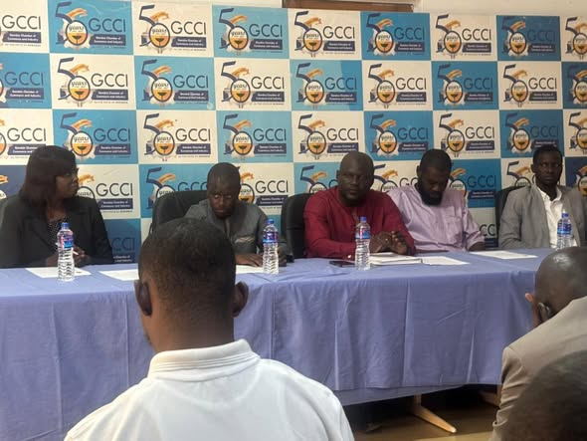
Glimpses
Albanian Competition Authority organised an essay competition among students from 6 public and private Universities.
The Gambia Competition and Consumer Protection Commission (GCCPC) organised at seminar at Gambia Chamber of Commerce and Industry (GCCI) office building.

Slide 33
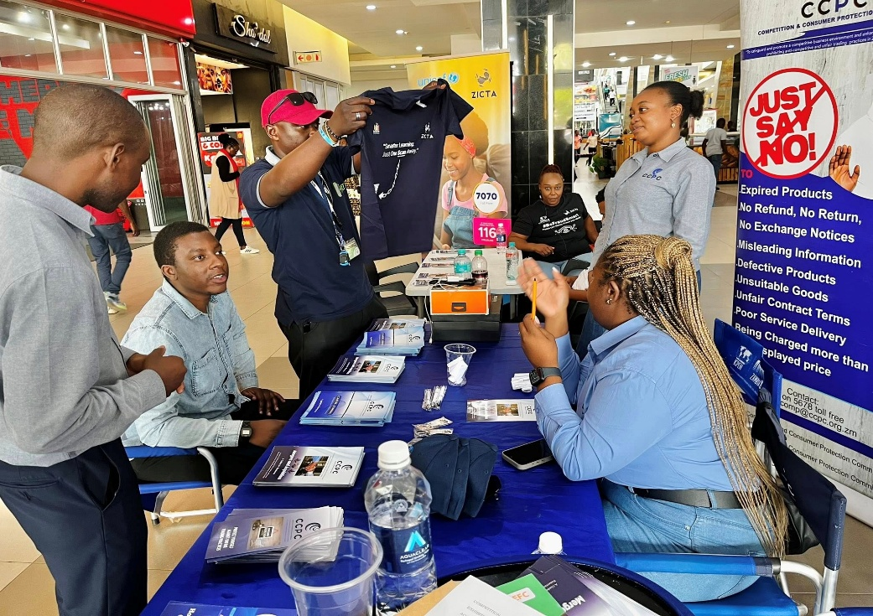
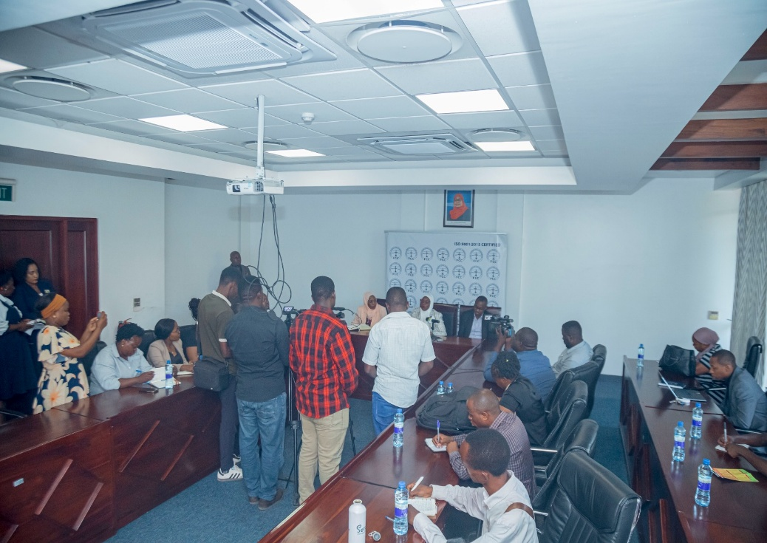
Glimpses
Competition and Consumer Protection Commission, and CUTS International organised exhibition at Levy Mall, Lusaka, Zambia
The Fair Competition Commission, Tanzania launched Competition Week in Dar es Salaam.

Slide 34
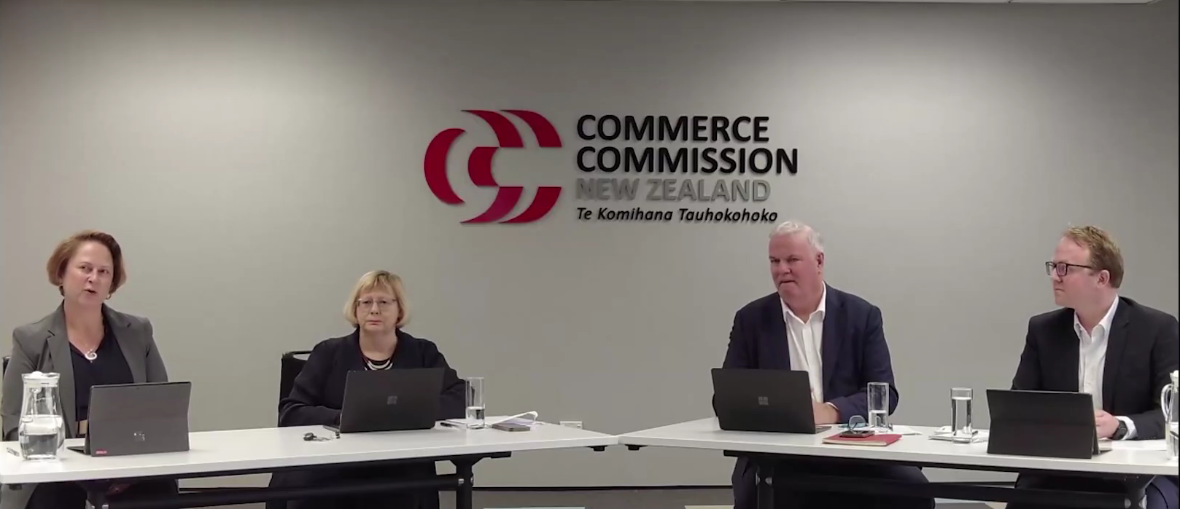
Glimpses
Commerce Commission, New Zealand organised a webinar on “Navigating the Rise of AI.”

Slide 35




CUTS Compendiums…. since 2011

Slide 36



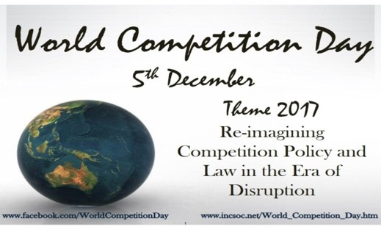
CUTS Compendiums…. since 2011

Slide 37
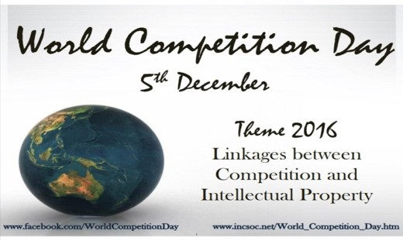

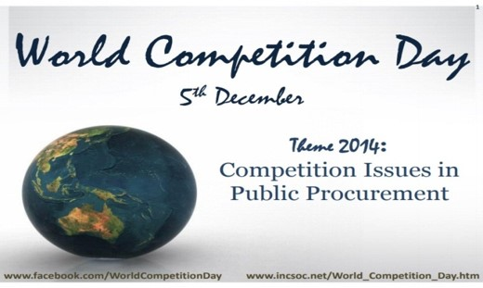

CUTS Compendiums…. since 2011

Slide 38


CUTS Compendiums…. since 2011

Slide 39

CUTS Compendiums…. since 2011
Special Edition consists of selected articles written by renowned experts…

Slide 40



Thank You
Suggestions are welcome for the next year’s theme (i.e. 5th December 2026)
For further information & suggestions, please contact:
Ujjwal Kumar, ujk@cuts.org and/or Neha Shrivastava, nsh@cuts.org

