Slide 1
World Competition Day 5th December
INCSOC
Theme 2018
Digital Economy, Innovation and Competition
www.facebook.com/WorldCompetitionDay
www.incsoc.net/World_Competition_Day.htm

Slide 2
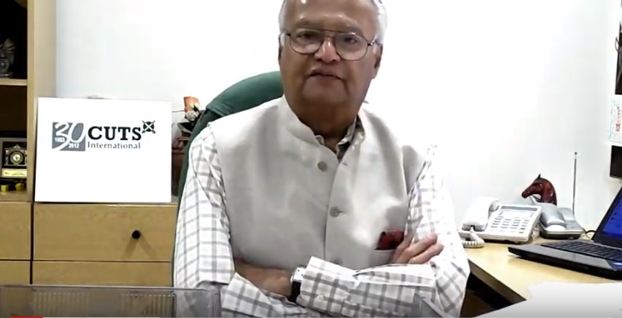
Why World Competition Day?
Pradeep S Mehta
Secretary General, CUTS International

Slide 3
Themes… since 2010
2010 International Air-transport Cartels and its Impact on Developing Countries
2011 Cartels and their Harmful Effects on Consumers
2012 & 2013 Adverse Impact of Cartels on the Poor
2014 & 2015 Competition Issues in Public Procurement
2016 Linkages between Competition and Intellectual Property
2017 Re-imagining Competition Policy and Law in the Era of Disruption
2018 Digital Economy, Innovation and Competition

Slide 4
Support from Countries ... since 2010
Competition agencies called upon UNCTAD towards a formal adoption of the Day
Competition Promotion and Consumer Protection Directorate,
Afghanistan
Albanian Competition Authority, Albania
The State Commission for the Protection of Economic Competition of Armenia
Austrian Federal Competition Authority, Austria
Competition Commission of Bangladesh

Slide 5
Support from Countries ... since 2010
Competition agencies called upon UNCTAD towards a formal adoption of the Day
Commission on Protection of Competition, Bulgaria
Commission for the Protection of Competition, Cyprus
The Office for the Protection of Competition, Czech Republic
Competition Superintendence (SC), El Salvador
Fiji Commerce Commission, Fiji

Slide 6
Support from Countries ... since 2010
Competition agencies called upon UNCTAD towards a formal adoption of the Day
Gambia Competition Commission, Gambia
Competition Agency of Georgia
Bundeskartellamt, Germany
The Hungarian Competition Authority (GVH), Hungary
Competition Protection Agency, Republic of Kazakhstan

Slide 7
Support from Countries ... since 2010
Competition agencies called upon UNCTAD towards a formal adoption of the Day
Competition Council, Republic of Latvia
Competition Council of the Republic of Lithuania
Competition Commission of Mauritius
Namibian Competition Commission, Namibia
Competition Commission of Pakistan

Slide 8
Support from Countries ... since 2010
Competition agencies called upon UNCTAD towards a formal adoption of the Day
Office of Competition and Consumer Protection (UOKiK), Poland
Philippines adopted 5th December as a National Competition Day
Federal Antimonopoly Service, Russia
Antimonopoly Office of the Slovak Republic, Slovakia
Spanish Competition Authority (CNC), Spain

Slide 9
Support from Countries ... since 2010
Competition agencies called upon UNCTAD towards a formal adoption of the Day
Competition Tribunal, South Africa
Swedish Competition Authority (KONKURRENSVERKET) Sweden
Competition Commission, Switzerland
Fair Competition Commission, Tanzania
The Antimonopoly Committee of Ukraine

Slide 10
Support from Countries ... since 2010
Competition agencies called upon UNCTAD towards a formal adoption of the Day
Vietnam Competition Authority, Vietnam
Competition and Consumer Protection Commission, Zambia
Competition and Tariff Commission, Zimbabwe

Slide 11
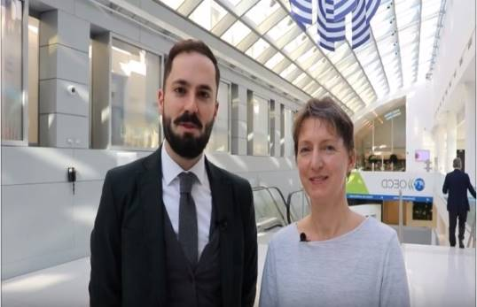
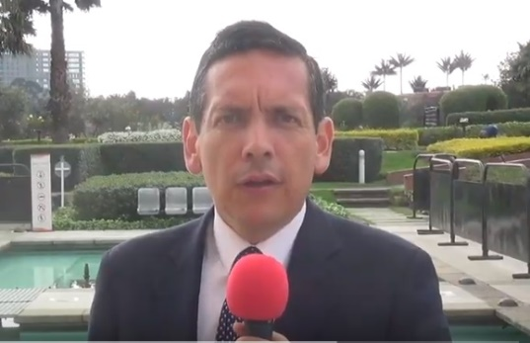
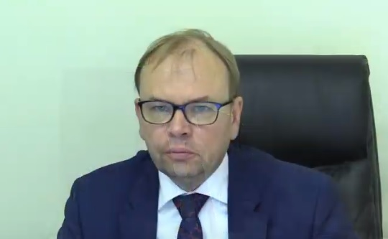
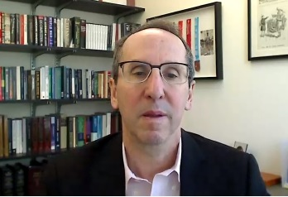
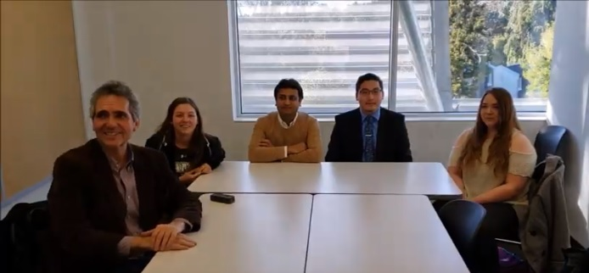
‘Videos’ expressing support to adopt WCD
OECD
GIZ, Indonesia
Supertintendence of Industry and Commerce, Colombia
Competition Authority, Estonia
Loyola University Chicago, USA
Thomas Jefferson University, USA

Slide 12
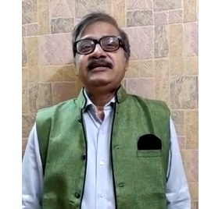
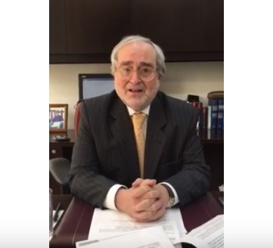
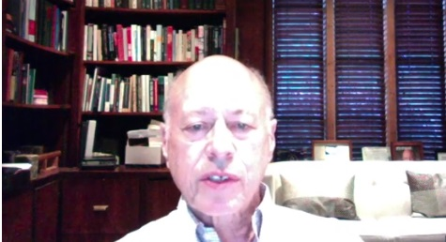
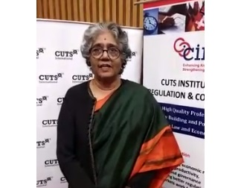
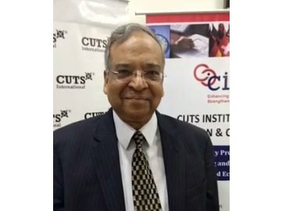
‘Videos’ expressing support to adopt WCD
Surendra Kanstiya Company Secretary, India
Ibarra Abogados
Colombia
The American Antitrust Institute, USA
Geeta Gouri
Former Member, CCI, India
Dhanendra Kumar
Former Chairman CCI, India

Slide 13
‘Actions’ taken around the world…2018
In Media | Country
"Competitiveness and Business" Forum, organized by the Competition Authority Press Release, Competition Authority of Albania, December 14, 2018 Roundtable “Competition in function of regional development Albania-Kosovo” Press Release, Competition Authority of Albania Roundtable "Competition in function of economic development” Press Release, Competition Authority of Albania, November 16, 2018 Roundtable "Competition in function of economic development” Press Release, Competition Authority of Albania, November 23, 2018 | Albania
CUTS calls on government to prioritise passage of competition law Ghana News Agency, December 06, 2018 | Ghana

Slide 14
‘Actions’ taken around the world…2018
In Media | Country
World Competition Day was celebrated in Georgia Press Release, Competition Agency YouTube Business Time Facebook Facebook On December 5, the EU project "Support of the Competition Agency of Georgia" and the Competition Agency will hold a seminar Mkhare, December 05, 2018 International Day of Competition is Celebrated in Georgia December 05, 2018 Commersant Medianews Mkhare | Georgia

Slide 15
‘Actions’ taken around the world…2018
In Media | Country
This is the second year Georgia celebrates World Competition Day: Nodar Khaduri Press Release, Competition Agency | Georgia
On World Competition Day, CUTS Releases a Study on Competition Concerns in Cross-border E-commerce Press Release, December 05, 2018 | Geneva
Existing competition tools inadequate to address issues related to monopoly of data, feel experts December 06, 2018 The Economic Times The Times of India Business Today Business Standard DAILYEXCELSIOR.COM | India

Slide 16
‘Actions’ taken around the world…2018
In Media | Country
India sees market control as product of data dominance in digital economy – 9th WCD conference PaRR, December 06, 2018 | India
Competition enforcement and consumer protection in a digital economy Standard Digital, December 05, 2018 | Kenya
One entrepreneur out of ten in Latvia is ready to deliberate competition distortion for gaining illegal profit Press Release, Competition Council of Latvia, December 06, 2018 Video Competition "More in competition” Press Release, Competition Council of Latvia | Latvia
Malawi to commemorate World Competition Day Malawi News Agency, December 02, 2018 | Malawi

Slide 17
‘Actions’ taken around the world…2018
In Media | Country
World Competition Day: CAP launches online newspaper Consom'Acteur Le Defi Media, December 06, 2018 | Mauritius
World Competition Day: Stakeholders call for speedy passage of competition bill World Stage, December 05, 2018 Healthy competition grows businesses – CPC December 06, 2018 News Agency of Nigeria Today Adamawa Celebrities Nigeria News Nigeria Latest News | Nigeria
ICCC marks World Competition Day The National, December 06, 2018 | Papua New Guinea

Slide 18
‘Actions’ taken around the world…2018
In Media | Country
World Competition Day Consumer Affairs Authority | Sri Lanka
Competition and Consumer Protection Commission (CCPC) celebrated WCD 2018 One Love Radio, December 03, 2018 Millennium Radio, December 03, 2018 Hot FM (Consumer Feedback), December 04, 2018 Live FM, December 05, 2018 Money FM, December 05, 2018 | Zambia
Fair competition key for sustainable growth Chronicle, December 06, 2018 | Zimbabwe

Slide 19
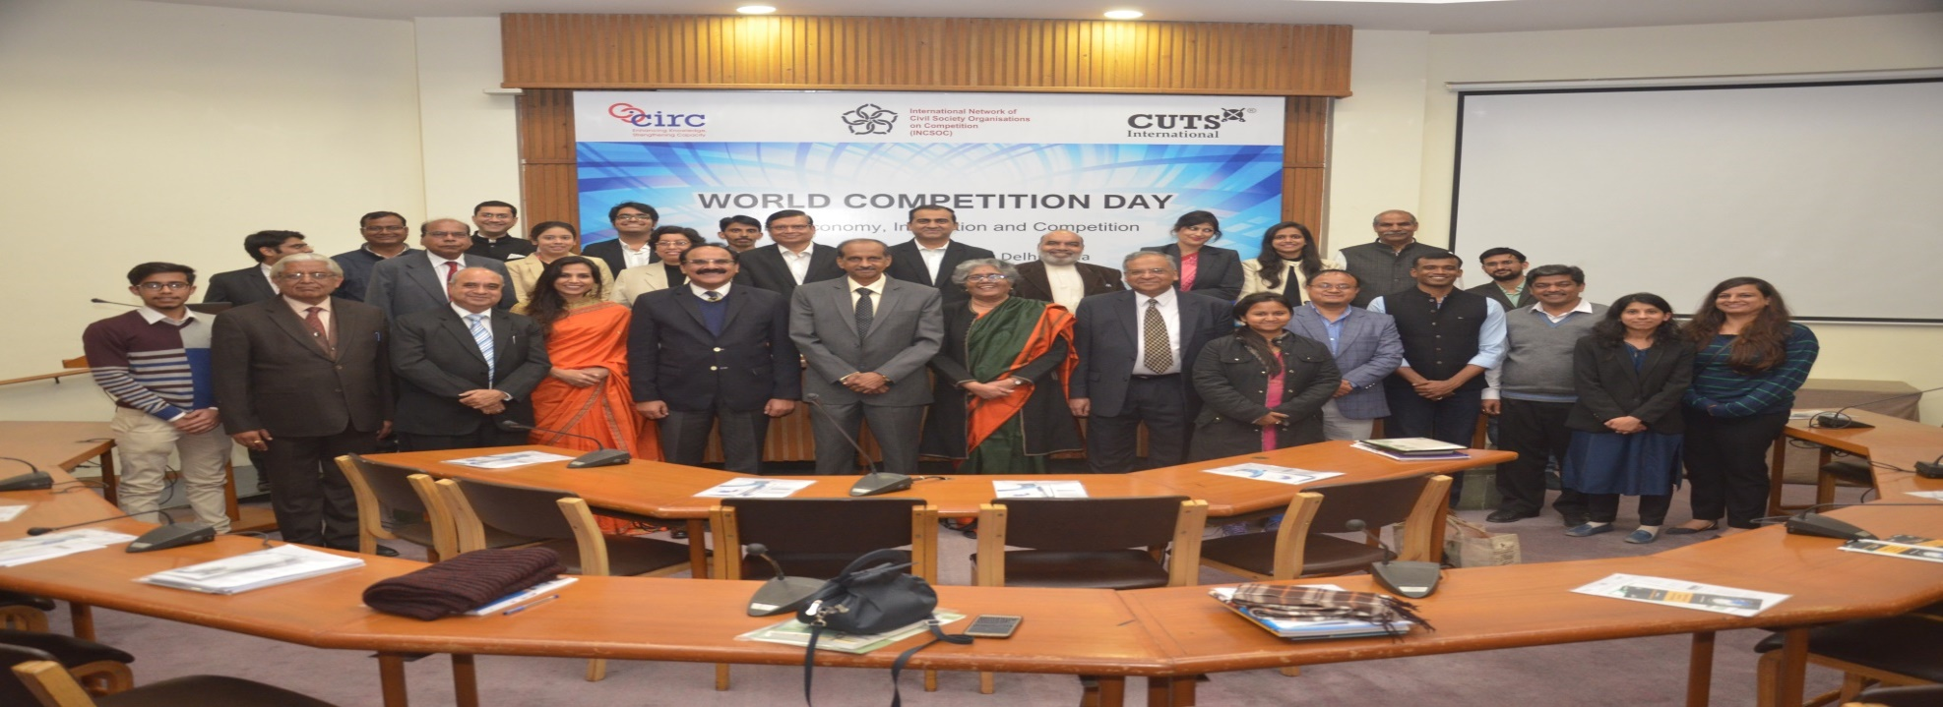
Glimpses
Consumer Unity & Trust Society (CUTS) and CUTS Institute for Regulation and Competition (CIRC) organised a panel discussion in the presence of representatives from Competition Commission of India, industry, law firms, media, etc. on “Digital Economy, Innovation and Competition” in New Delhi.

Slide 20
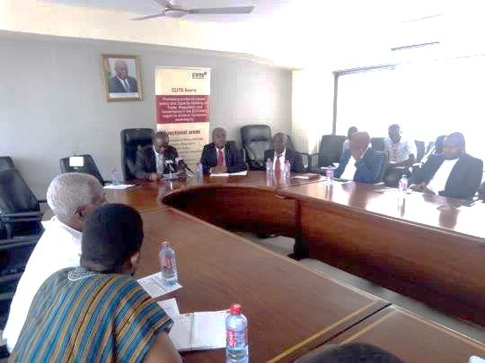
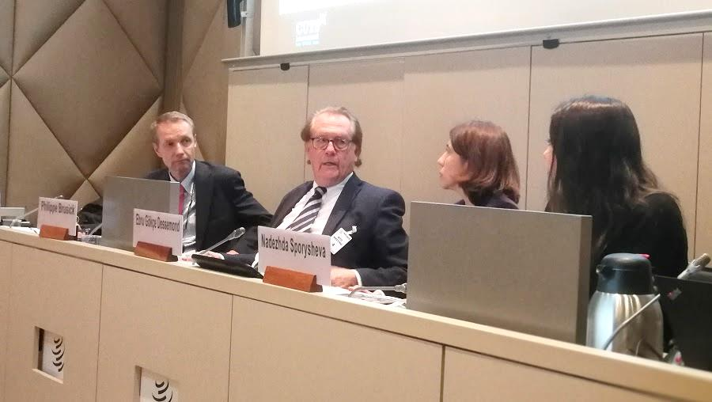
Glimpses
CUTS Ghana organised a roundtable discussion on “Competing Without Market Rules” in Accra.
CUTS Geneva released a Study on ‘Competition Concerns in Cross-border E-commerce’ in Geneva.

Slide 21
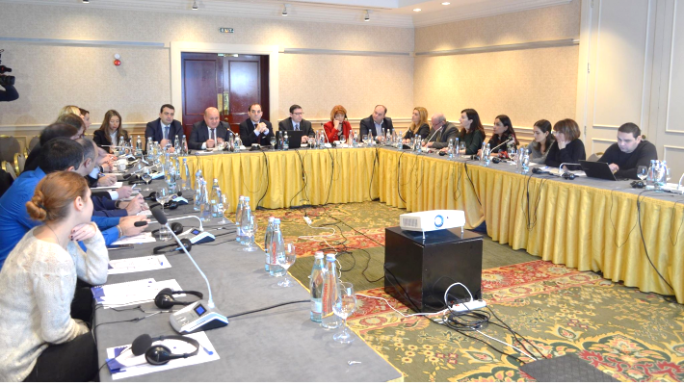
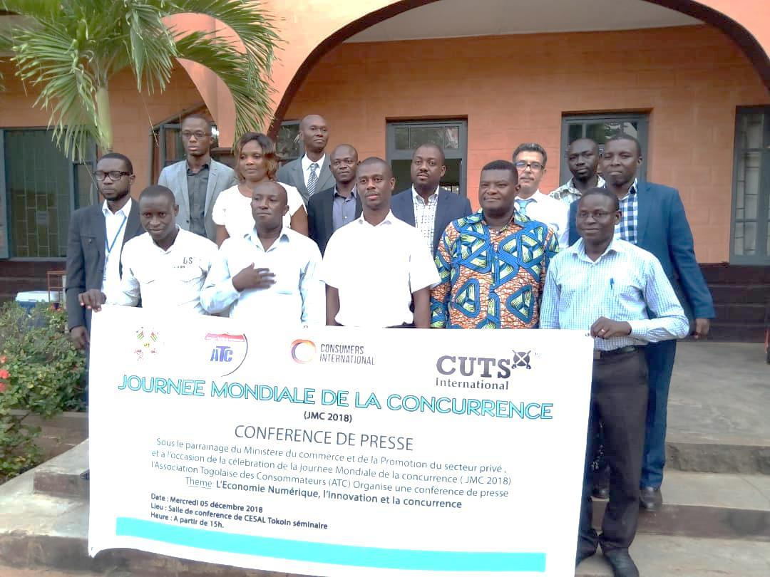
Glimpses
Georgian Competition Agency hosted a seminar on "EU Support in the Field of Competition”.
Togolese Association of Consumers (ATC) organised a press conference.

Slide 22
Thank You
REQUEST FOR SUGGESTIONS: THEME FOR 2019
Suggestions are welcome for the next year’s theme (i.e. 5th December 2019)
Webpage: www.incsoc.net/World_Competition_Day.htm
Facebook : www.facebook.com/WorldCompetitionDay
Twitter: Use Hashtag #WorldCompetitionDay and tag @CUTSCCIER
For further information & suggestions, please contact: Udai S. Mehta, usm@cuts.org
Sidharth Narayan, sid@cuts.org

